Slide 1
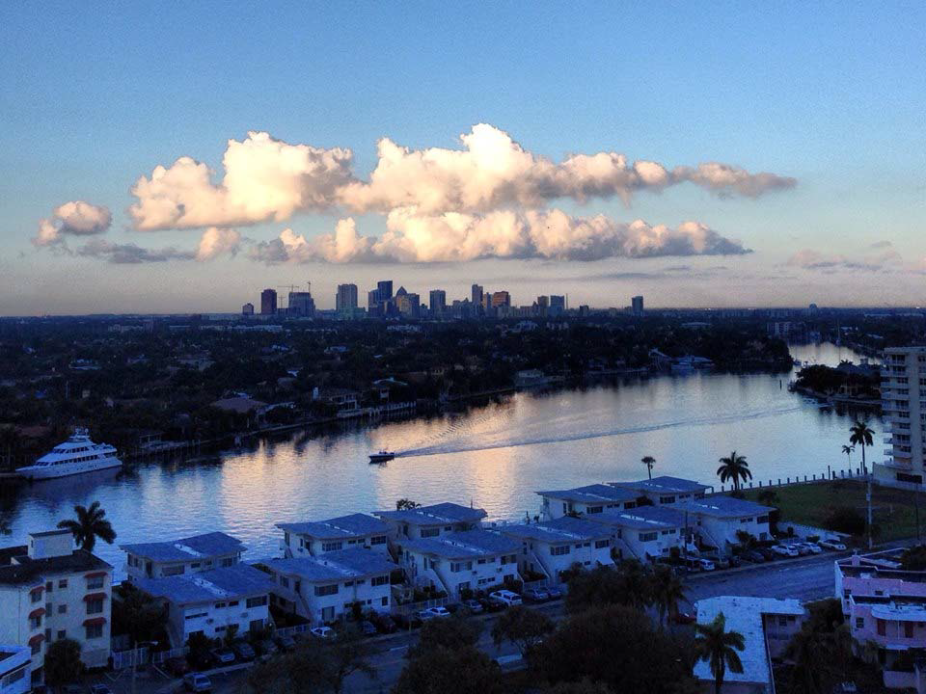
Background slide during set-up– before launch slide begins
CITY OF FORT LAUDERDALE

Slide 2
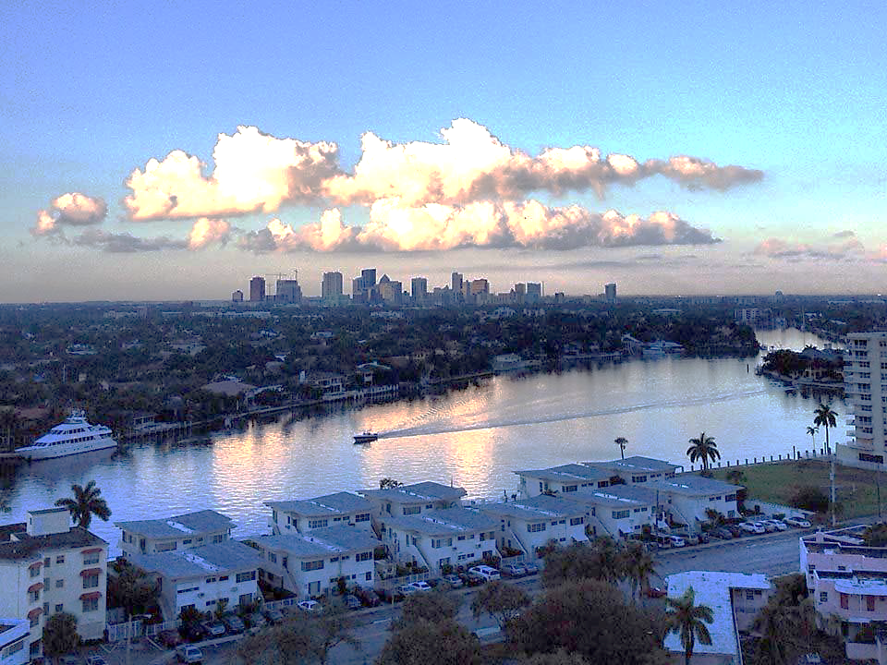
Launch Welcome slide
RCAP IMPLEMENTATION WORKSHOP
ADAPTATION ACTION AREA PLANNING
The Fort Lauderdale Journey
SUSANNE M. TORRIENTE, ASSISTANT CITY MANAGER
CITY OF FORT LAUDERDALE
ADRIENNE EHLE, ENVIRONMENTAL ANALYST
PUBLIC WORKS - SUSTAINABILITY DIVISION
CITY OF FORT LAUDERDALE
AUGUST 28, 2014

Slide 3
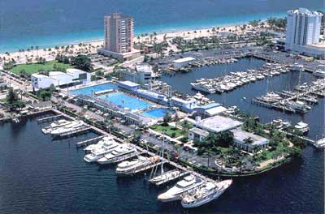
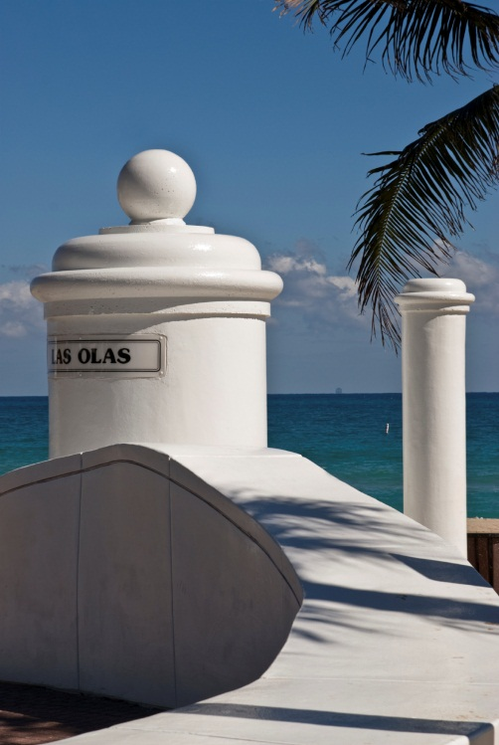
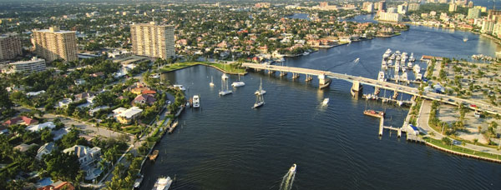
The Fort Lauderdale Journey
COLLABORATION WITH OUR PARTNERS
Timeline
Integrating
Connecting the Dots
Grant Timeline
Outreach
Draft Language
Next Steps

Slide 4
QUICK Timeline Re-Cap: Arrival new City Management, awarded the AAA grant, Org changes, signed AAA ILA
A snapshot of our City’s story
COLLABORATION WITH OUR PARTNERS
2011
2012
2013
2014
Florida State Community Planning Act
2012 Regional Climate Action Plan Adopted
Vision Plan and Strategic Plan Adopted
AAA Climate Adaptation Open House outreach
Creation of Sustainability Office housed in Public Works
AAA Interlocal Agreement signed & executed
We Are Ready Climate Resiliency Booth outreach
Start of new City administration
Began AAA Outreach
AAA grant awarded to City
Began Neighborhood Surveys
AAA Reviews and Approvals
Outreach to City of Fort Lauderdale Civic Associations
Proposed Comprehensive Plan AAA Goal Objective and Policies
Began Citywide
Re-organization
Began Visioning Initiative Phase II
City of Fort Lauderdale’s Timeline
Notes:
Quick overview of our history with our AAA story beginning in 2011.
2011
Florida State Community Planning Act
CITY - New City Administration, Susy arrived at the City, got notice that we won the AAA grant,
CITY - 2012 Reorganization of City departments, creation of Sustainability Office in Public Works
2012 [ add speaking points]

Slide 5
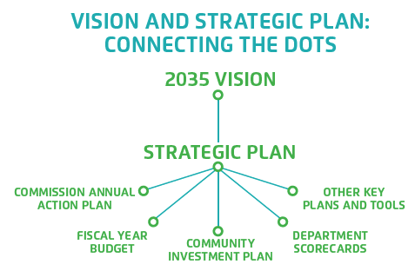
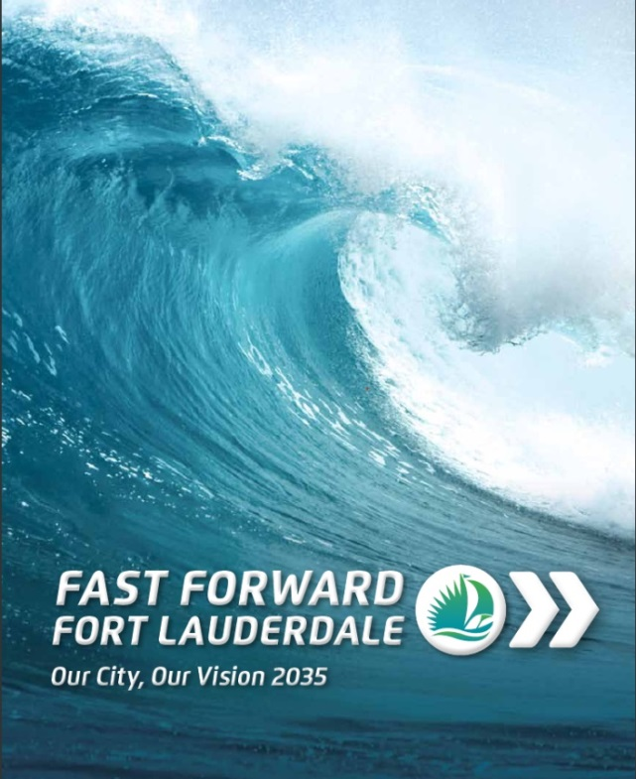
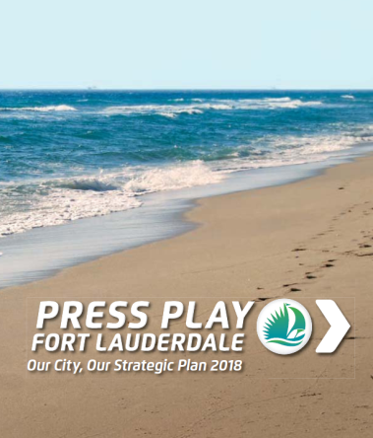
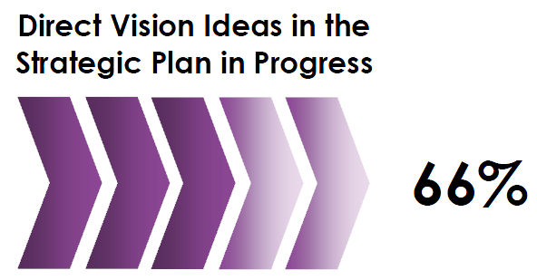
Connecting the dots : Our Vision & Strategic Plans
CONNECTING THE DOTS
2011
2012
2013
2014
Notes:
The Vision and Strategic Plan were adopted in 2013.
2013 and 2014 , WE ARE connecting the dots, aligning our vision with daily operations.

Slide 6
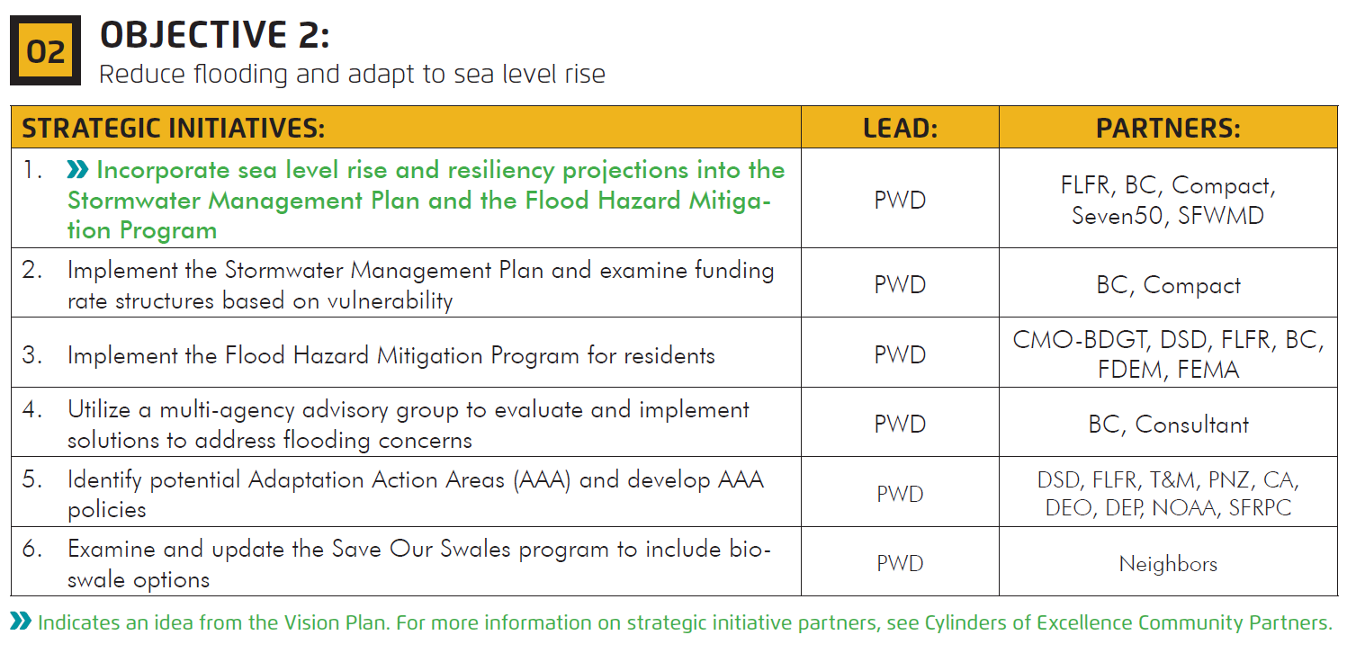
AAAs Strategic Initiative
City Strategic Plan
CONNECTING THE DOTS
INFRASTRUCTURE
Adaptation Action Areas are a Strategic Initiative in Press Play
Notes:
Here as seen in our Strategic Plan (Press Play).

Slide 7
Timeline Neighbor Outreach, Review & Approval Process
Neighbor Outreach
Oct 2013
Council of Fort Lauderdale Civic Associations
CONNECTING THE DOTS
Jan 2014
Climate Adaptation Open House
Apr 2014
Sustainability Advisory Board
June 2014
Hurricane Expo Climate Resiliency booth
Review and Approval Process
Jan 2014
Drafting of Policy Language
Apr 2014
Development Review Committee
No public comment

Unanimously voted
May 2014
YES
Recommendation
to City Commission
Planning and Zoning Board

Unanimously voted
June 2014
YES
City Commission
Transmittal to State

Slide 8
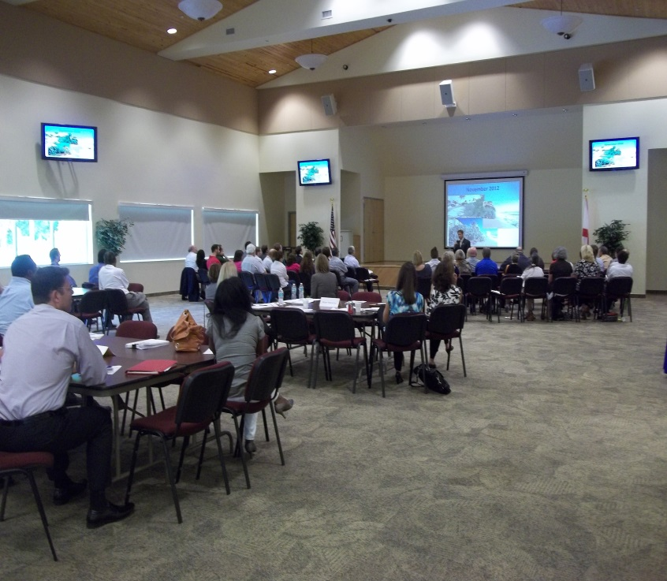
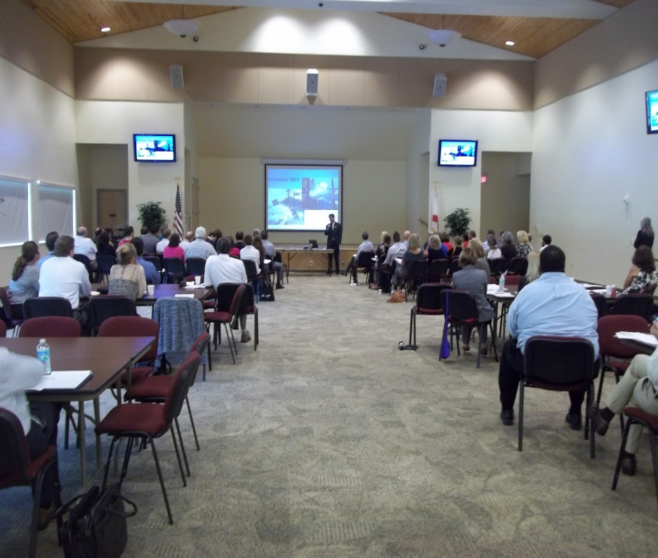
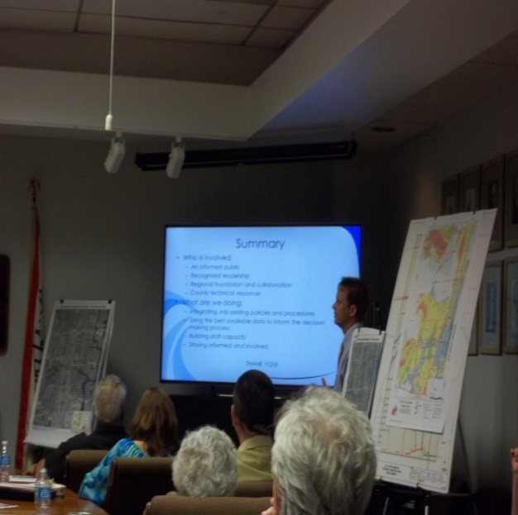
AAA Community outreach & dialogue
Adaptation Action Areas | Outreach
CLIMATE ADAPTATION
Broward County Sustainability Stewards
Broward American Planning Associations Workshop  June 2013
City of Fort Lauderdale Civic Associations  October 2013
In 2013, we started community outreach & dialogue with our Neighbors.
Notes:
In 2013, we started community outreach & dialogue with our Neighbors about Adaptation Action Areas.

Slide 9
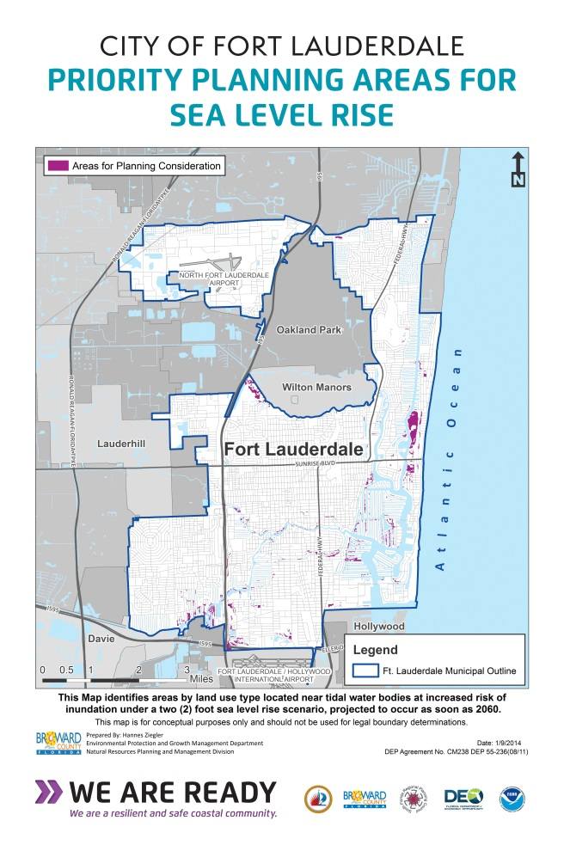
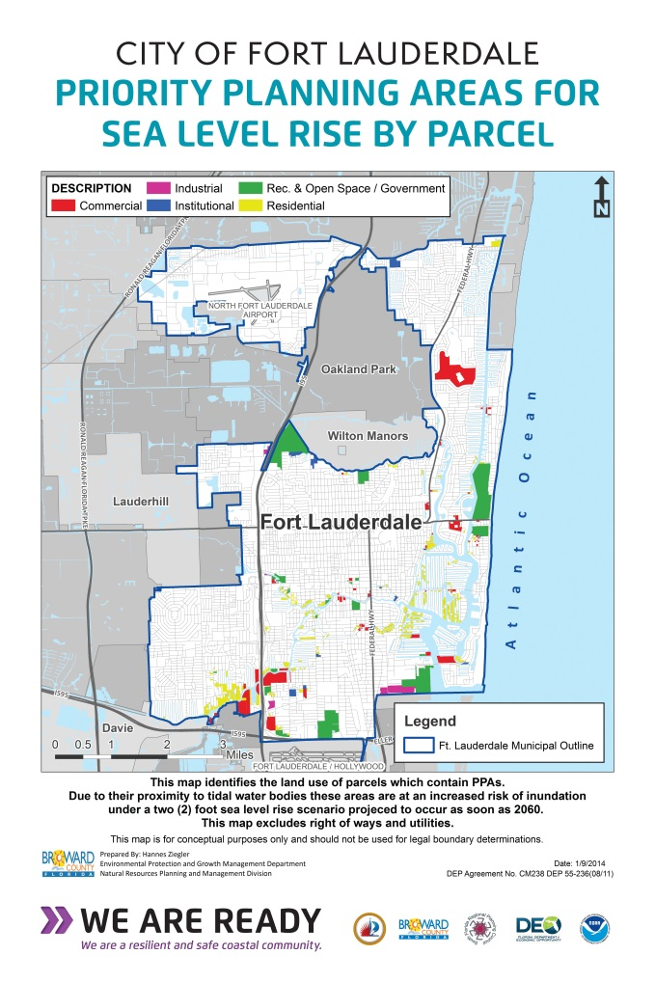
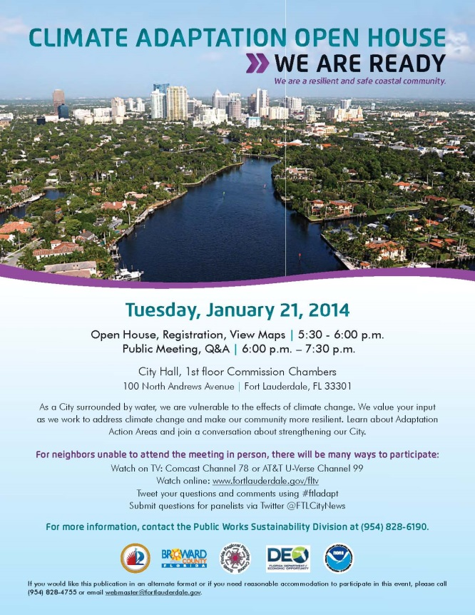
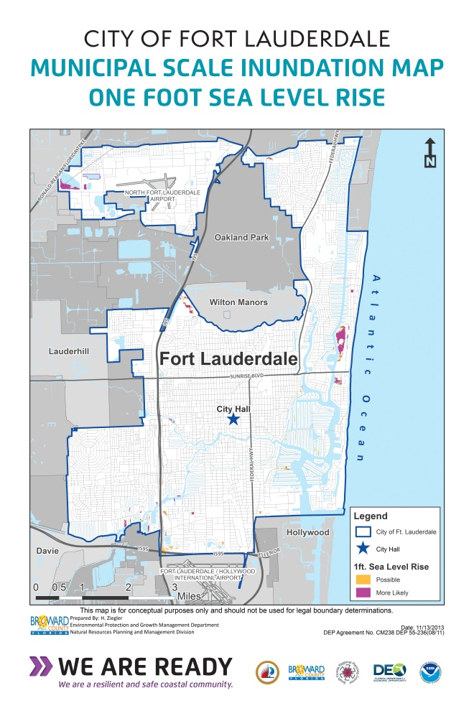
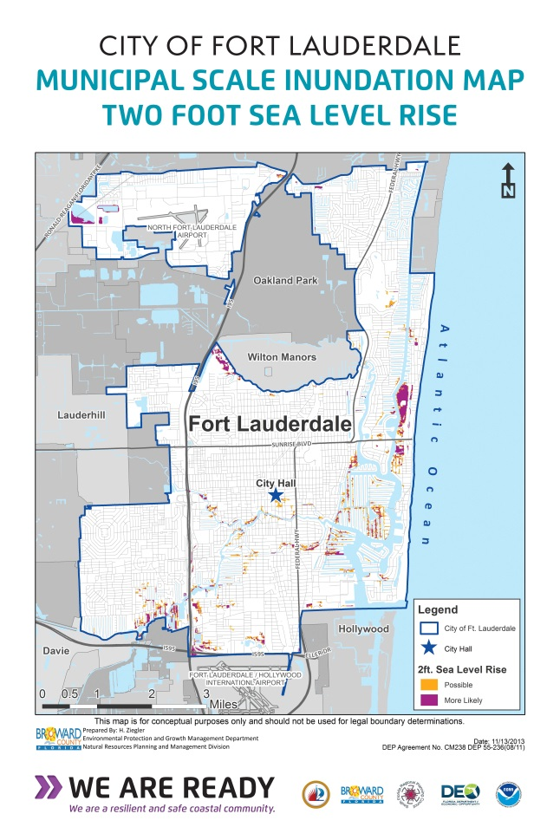
AAA flyer and We Are Ready maps
CONNECTING THE DOTS
Broward County assisted with maps, on display at outreach events.
Notes:
[We Are Ready maps we first branded for Climate Adaptation Open House and use at meetings & events [optional to say: also on display here today]
Innundation one foot, two foot
Priortity Planning Areas one foot,
Priortity Planning Areas by Parcel

Slide 10
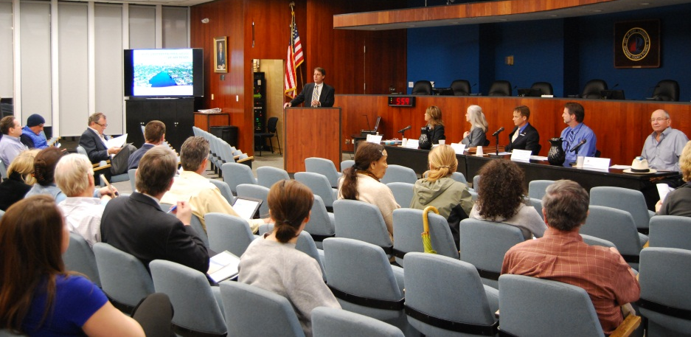
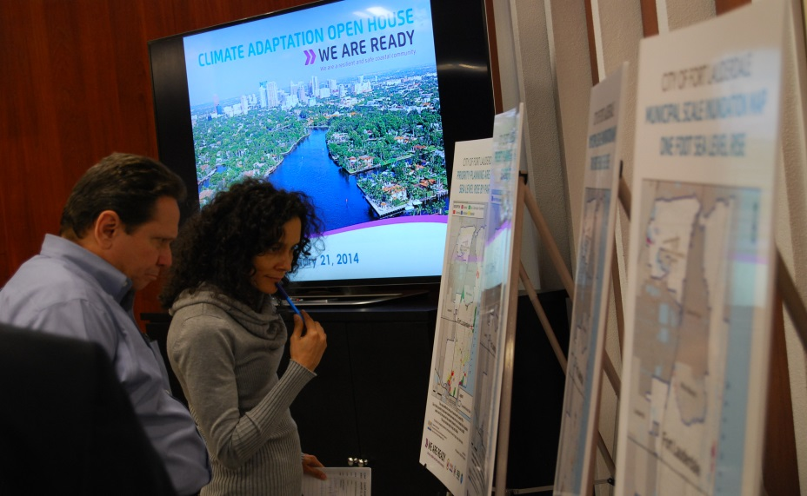
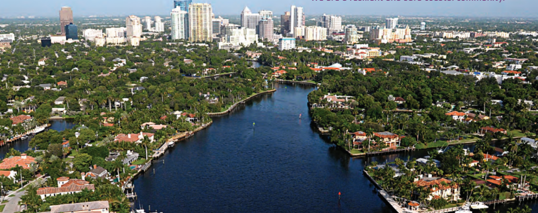
CLIMATE ADAPTATION Open House dialogue
CLIMATE ADAPTATION OPEN HOUSE
CLIMATE ADAPTATION
January 21, 2014
BROADCASTED LIVE ON FLTV
STREAMED ONLINE
INCORPORATED SOCIAL MEDIA: TWITTER & FACEBOOK
Dialogue with Neighbors at the Climate Adaptation Open House.

Slide 11
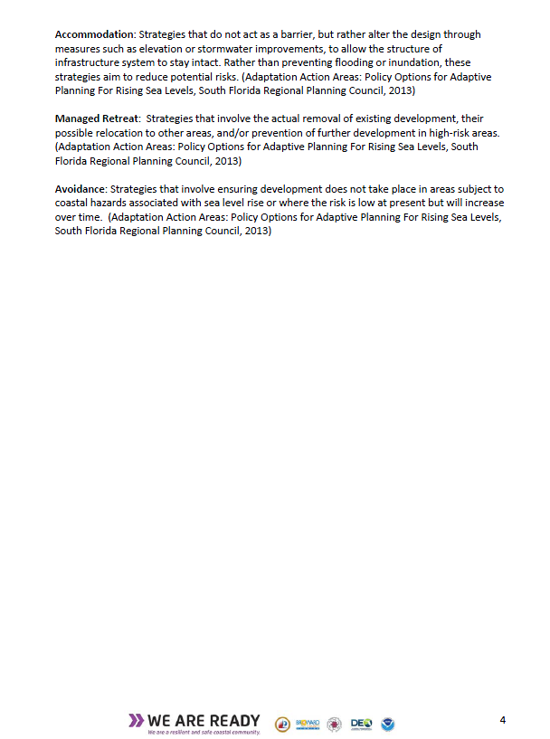
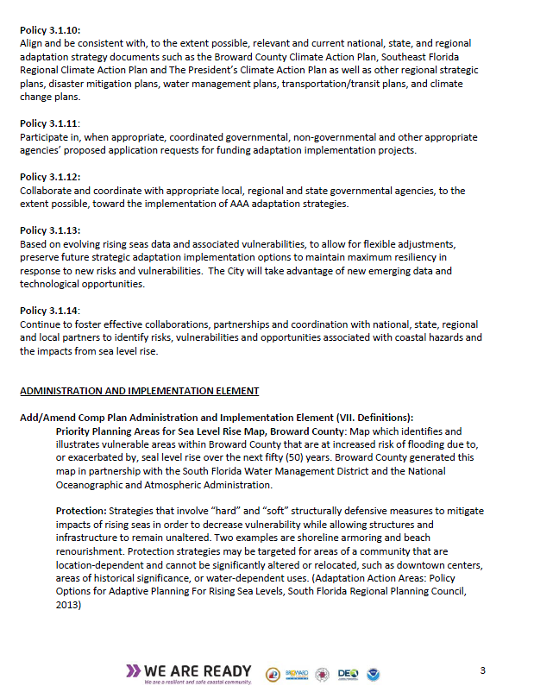
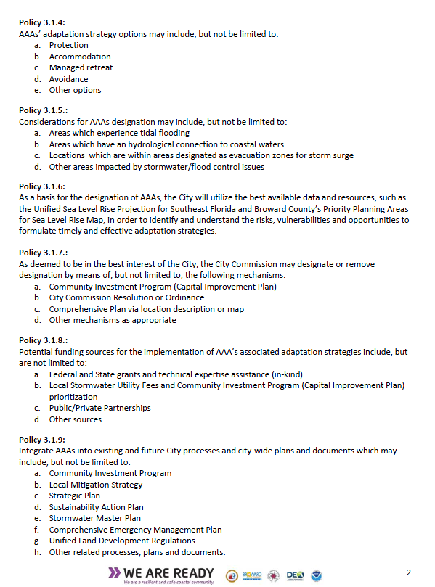
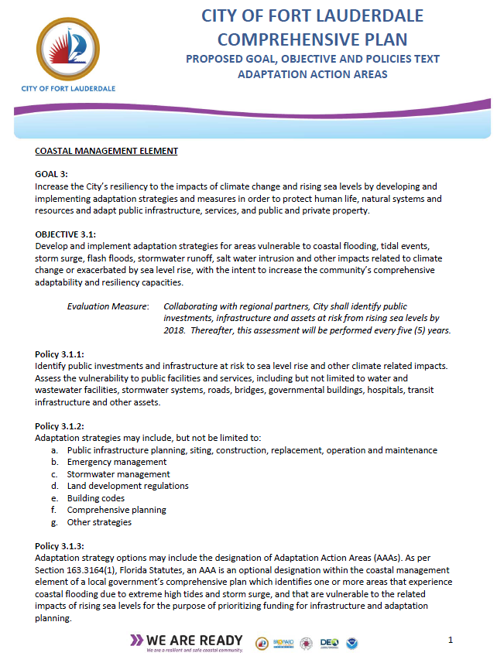
CLIMATE ADAPTATION AAA Pilot with our Partners
Review and Approval Process
CLIMATE ADAPTATION
We are first to write Adaptation Action Areas into our Comprehensive Plan.

Slide 12
AAAs Strategic Initiative
AAA Policies
CONNECTING THE DOTS
City of Fort Lauderdale Comprehensive Plan Proposed AAA Goal, Objective and Policies
Policy 3.1.1 – Identify public investments and infrastructure
Policy 3.1.2 – Adaptation Strategies
Policy 3.1.3 – Adaptation Action Areas (AAA)
Policy 3.1.4 – AAA adaptation strategy options
Policy 3.1.5 – Considerations for AAA designation
Policy 3.1.6 – Basis for the designation of AAAs
Policy 3.1.7 – City Commission mechanisms for designating AAAs
Policy 3.1.8 – Funding Sources
We are first to write Adaptation Action Areas into our Comprehensive Plan.

Slide 13
AAAs Strategic Initiative
AAA Policies
CONNECTING THE DOTS
City of Fort Lauderdale Comprehensive Plan Proposed AAA Goal, Objective and Policies
Policy 3.1.9 – Integration of AAAs into existing city processes and plans
Policy 3.1.10 – Alignment with national, state, and regional adaptation strategy documents
Policy 3.1.11 – Participate in other appropriate agencies’ proposed application requests for funding adaptation implementation projects
Policy 3.1.12 – Collaborate and coordinate
Policy 3.1.13 – Allow for flexible adjustments
Policy 3.1.14 – Foster effective collaborations and coordination to identify risks, vulnerabilities and opportunities associated with coastal hazards and sea level rise
We are first to write Adaptation Action Areas into our Comprehensive Plan.

Slide 14
Next Steps
COLLABORATION WITH OUR PARTNERS
Final City Commission approval – Oct-Nov
Stay tuned for
AAA Designation
Prioritized Funding

Slide 15
Conclusion
COLLABORATION WITH OUR PARTNERS
Talk and listen to ALL audiences
Build staff capacity
Integrate early and often
Leverage different projects with common goals

Slide 16
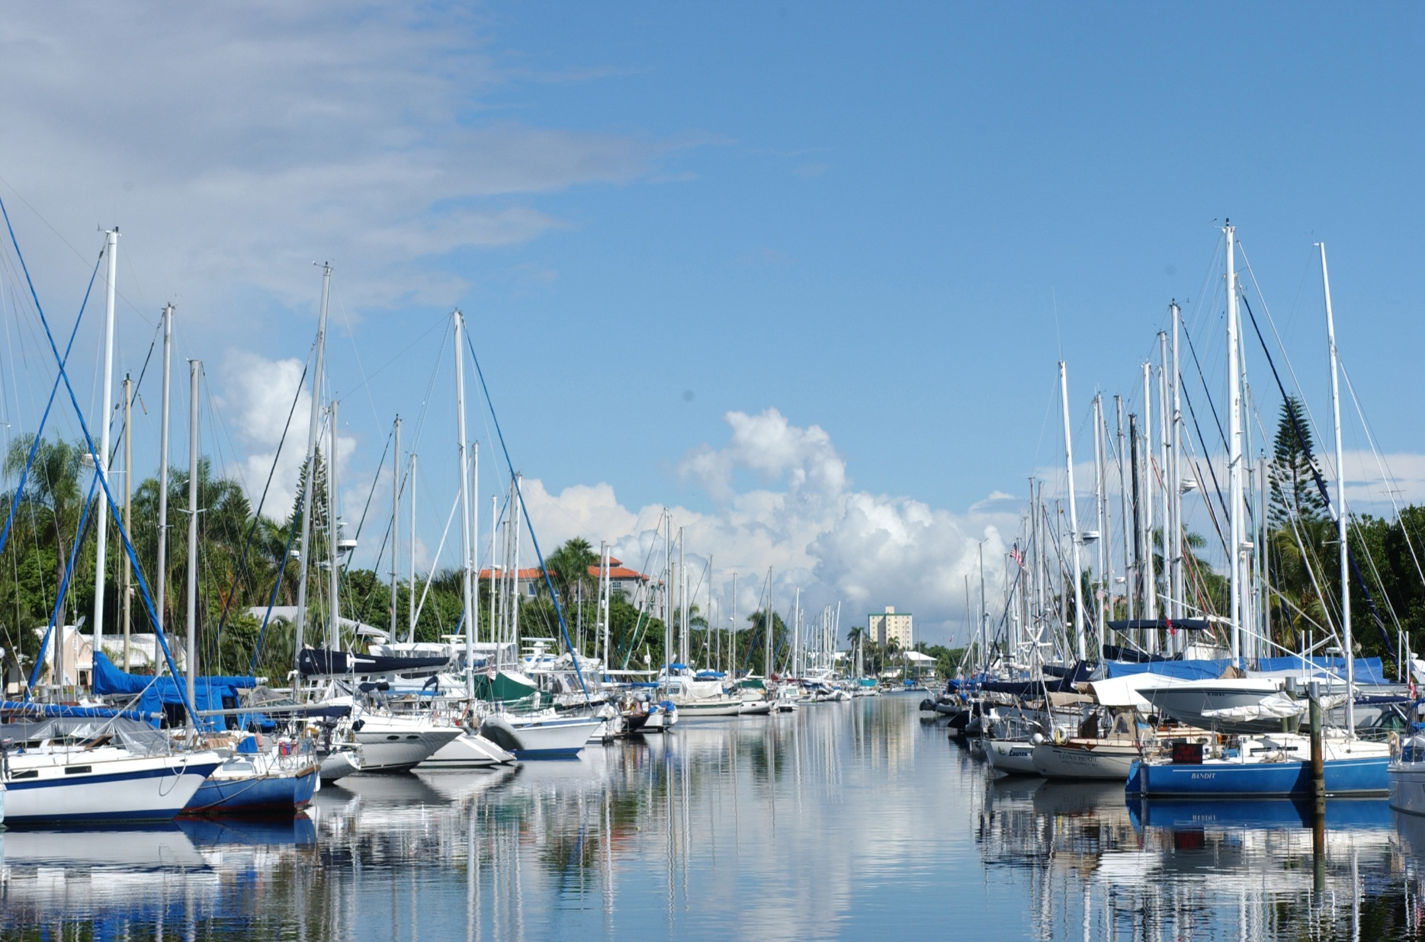
[placeholder] rotation ending slides here
ADAPTATION ACTION AREAS
Thank you.
[placeholder] rotation ending slides here
SUSANNE M. TORRIENTE
storriente@fortlauderdale.gov
PLACE HOLDER
END SLIDE
Insert full SUSTAINABILITY LAB IMAGE
ADRIENNE EHLE
aehle@fortlauderdale.gov

