Slide 1
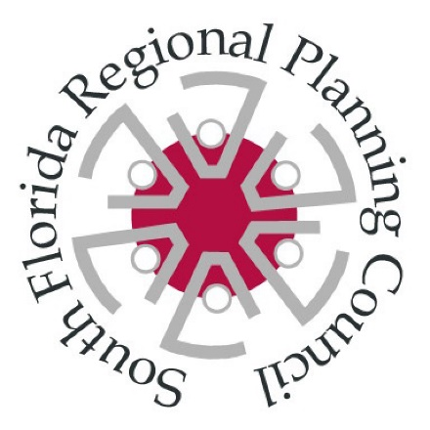
Adaptation Action Areas
Jim Murley
South Florida Regional Planning Council
AAA Workshop, August 28, 2014

Slide 2
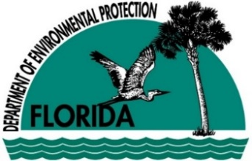
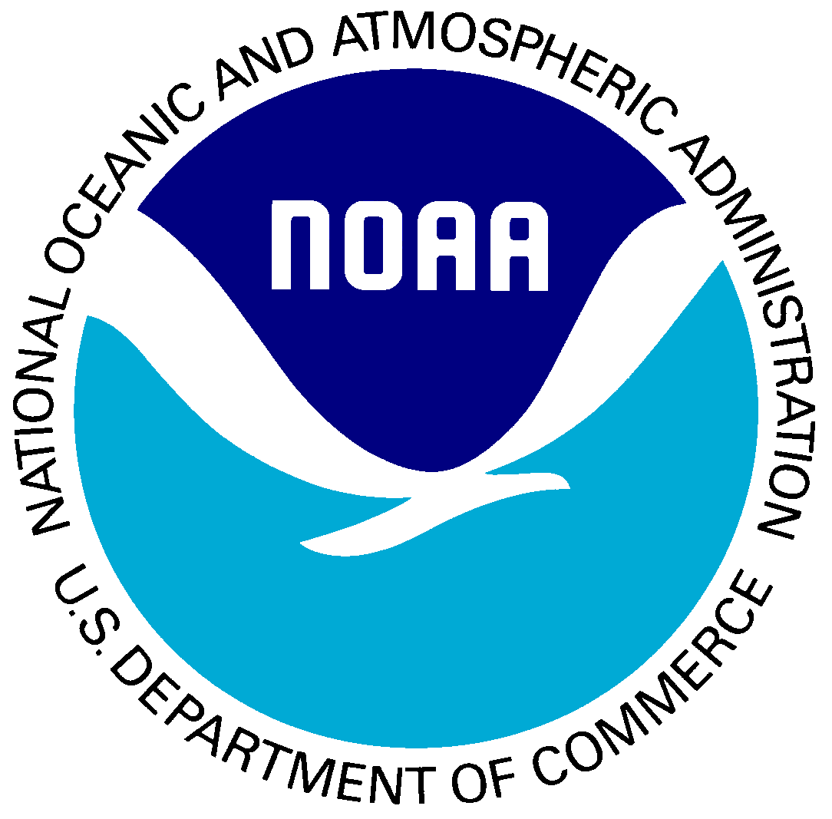
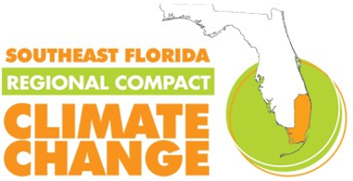
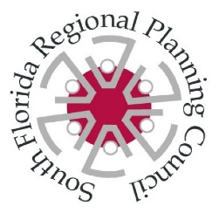

Slide 3
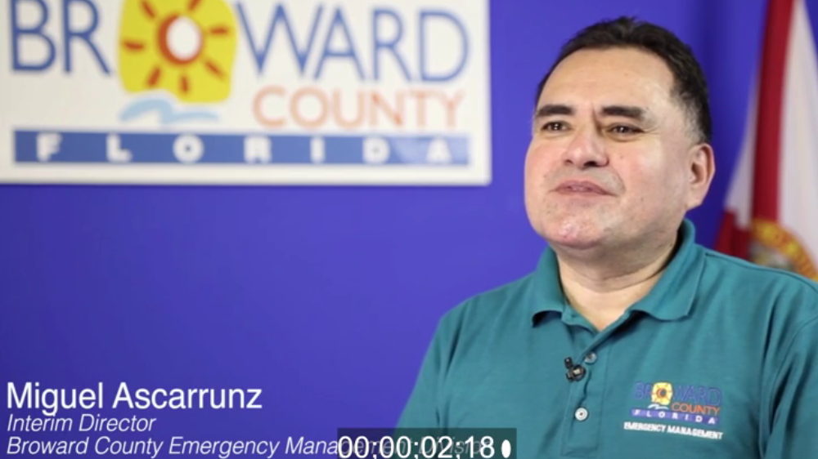
The South Florida Regional Planning Council is compiling resources including:
Podcasts and Video,
Policy Options for Adaptive Planning for Rising Sea Levels,
Case Study: Fort Lauderdale, Broward County, FL
A Planning Guidebook for Florida’s Local Governments

Slide 4
Section 163.3164(1), Florida Statutes Adaptation Action Area or “adaptation area” means a designation in the coastal management element of a local government’s comprehensive plan which identifies one or more areas that experience coastal flooding due to extreme high tides and storm surge, and that are vulnerable to the related impacts of rising sea levels for the purpose of prioritizing funding for infrastructure needs and adaptation planning.
Criteria for the adaptation action area may include, but need not be limited to:
areas for which the land elevations are below, at, or near mean high water;
which have hydrologic connection to coastal waters; and/or
which are designated as evacuation zones for storm surge.

Slide 5
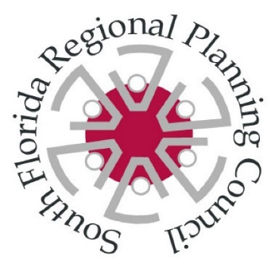
Section 163.3177(6)(g)(10), At the option of the local government, develop an adaptation action area designation for those low-lying coastal zones that are experiencing coastal flooding due to extreme high tides and storm surge and are vulnerable to the impacts of rising sea level. Local governments that adopt an adaptation action area may consider policies within the coastal management element to improve resilience to coastal flooding resulting from
high-tide events;
storm surge;
flash floods;
stormwater runoff; and
related impacts of sea-level rise.

Slide 6
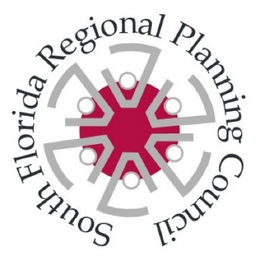
In 2010, the Board of County Commissioners for Broward, Miami-Dade, Monroe and Palm Beach Counties signed a Southeast Florida Regional Climate Change Compact. The Compact recognized that the South Florida region which comprises 30 percent of state’s population, has and will continue to be prone to coastal hazards, “the impacts of climate change, especially sea level rise”, and therefore “must give significant consideration to adaptation strategies designed to protect public infrastructure, property, water resources, natural areas and native species, and basic quality of life” (Southeast Florida Regional Climate Change Compact, 2010).
The Compact’s initiative to promote Adaptation Action Areas is tied directly to a strong request from Florida communities that the State provide guidance on how to implement Adaptation Action Areas and to the current effort to create such resources for the State.

Slide 7
A leader in coastal hazard planning
Enhanced Local Mitigation Strategy
has comprehensive sections on SLR mapping impacts of 1, 2, and 3 ft SLR scenarios
Climate change action plan
Climate change task force.
first to integrate AAA language into their comprehensive plan w Climate Change Element.

Slide 8
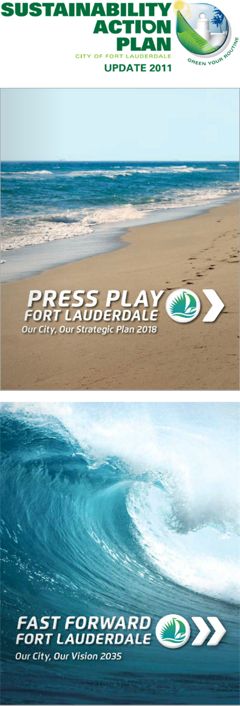
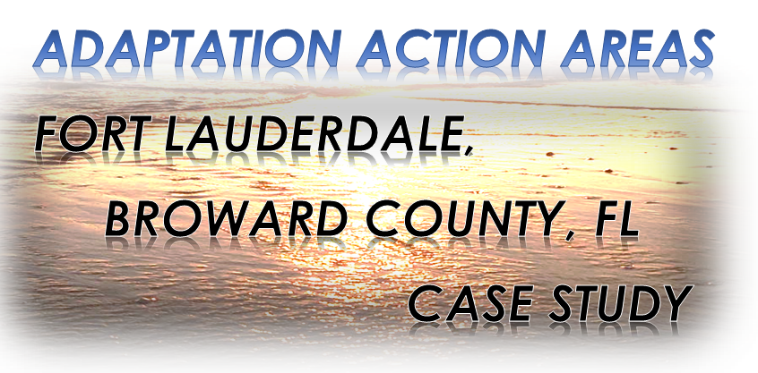
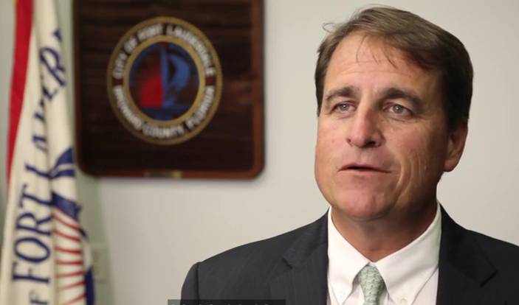
v

Slide 9
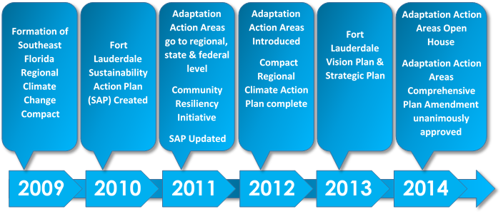
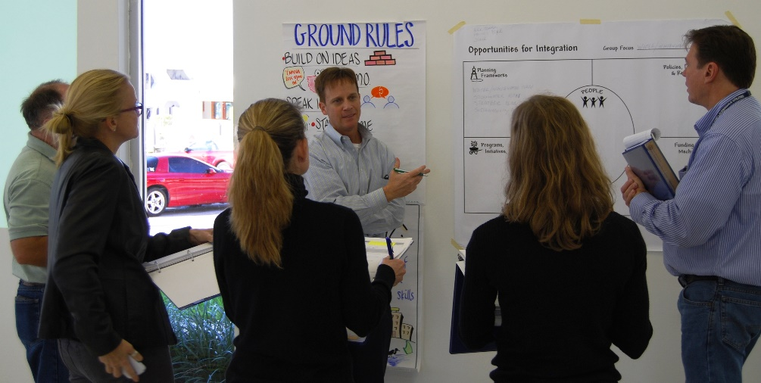

Slide 10
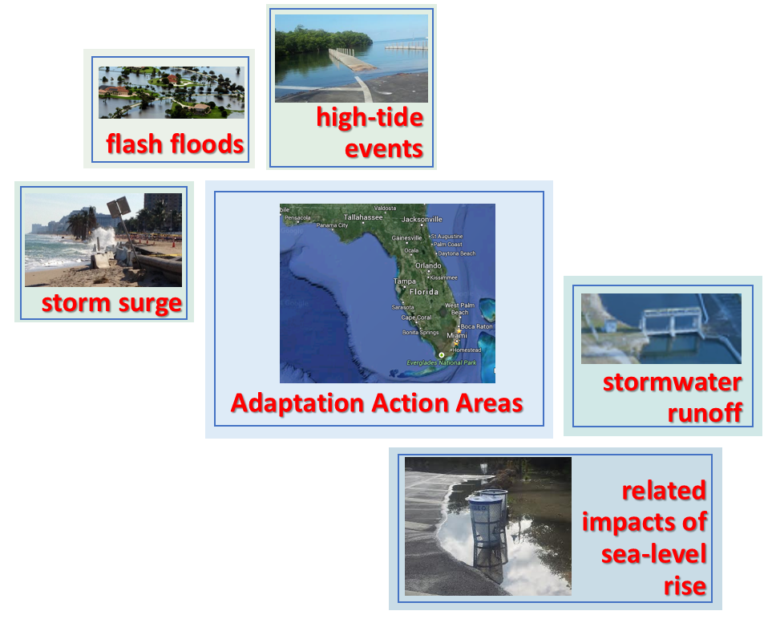
Strategies for Adaptation Action Areas may include
Protection
Accommodation
Managed retreat
Avoidance
Other options

Slide 11
Successful Approach includes
Partnerships and Support
Integration
Capacity Building
Community Engagement

Slide 12
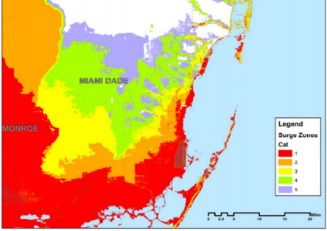
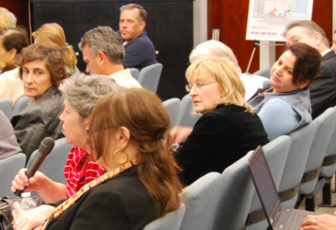
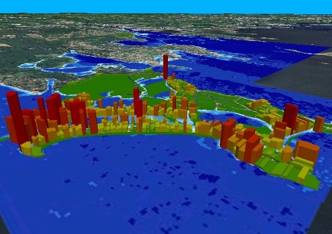
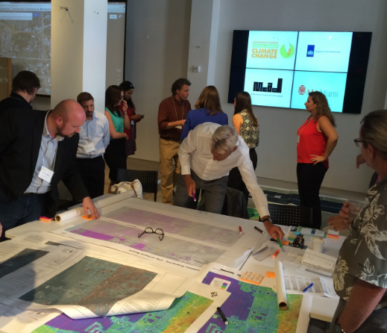
Identify Goals for Your Community
Identify Tools, Policy, & Funding
Reassess New Data and Options Periodically
Identify Baseline Risk

Slide 13
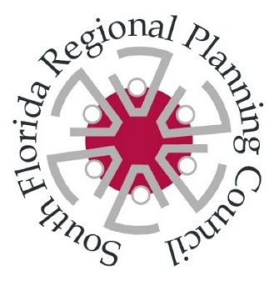
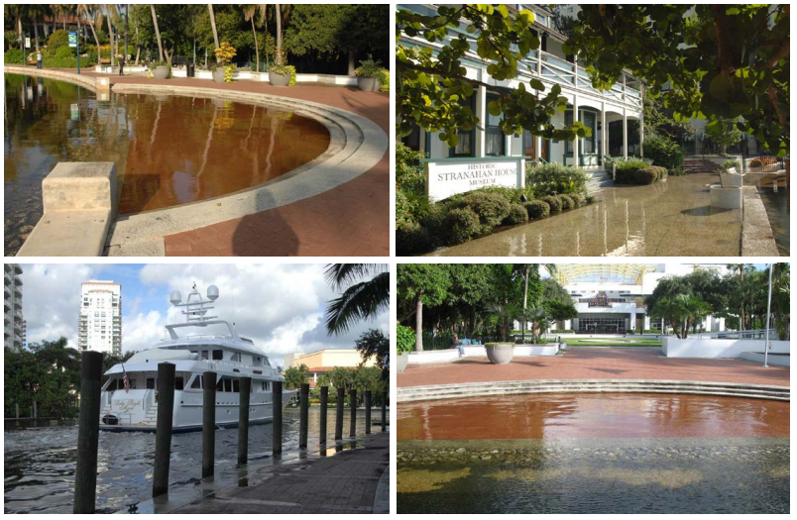
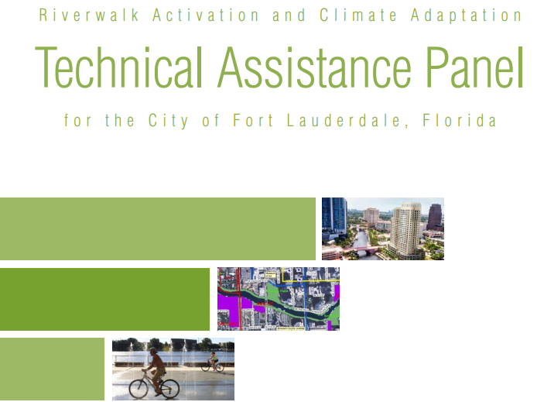
The October 2010 high tides along the Riverwalk, as seen (clockwise from top-left) along the New River, at the Stranahan House, in front of the Museum of Science and Discovery, and along the Riverwalk. Photo Source: Final Report from the Urban Land Institute Technical Assistant Panel on Climate Adaptation.

Slide 14
