Slide 1
DOE Resources,
Tools, and Programs to Help
Local Governments be more
Efficient and Competitive
Energy Efficient Public Buildings Workshop
September 17th, 2015
Notes:
Welcome
Thank you for joining us
Introduce myself and Adam

Slide 2


Presenters
Sarah Zaleski
Policy Advisor
U.S. Department of Energy
Adam Guzzo
Policy Advisor
U.S. Department of Energy

Slide 3
To Discuss Today
Opportunity before local governments
DOE resources, tools, and programs for local governments
Critical building blocks of local government energy management
How to access resources

Slide 4
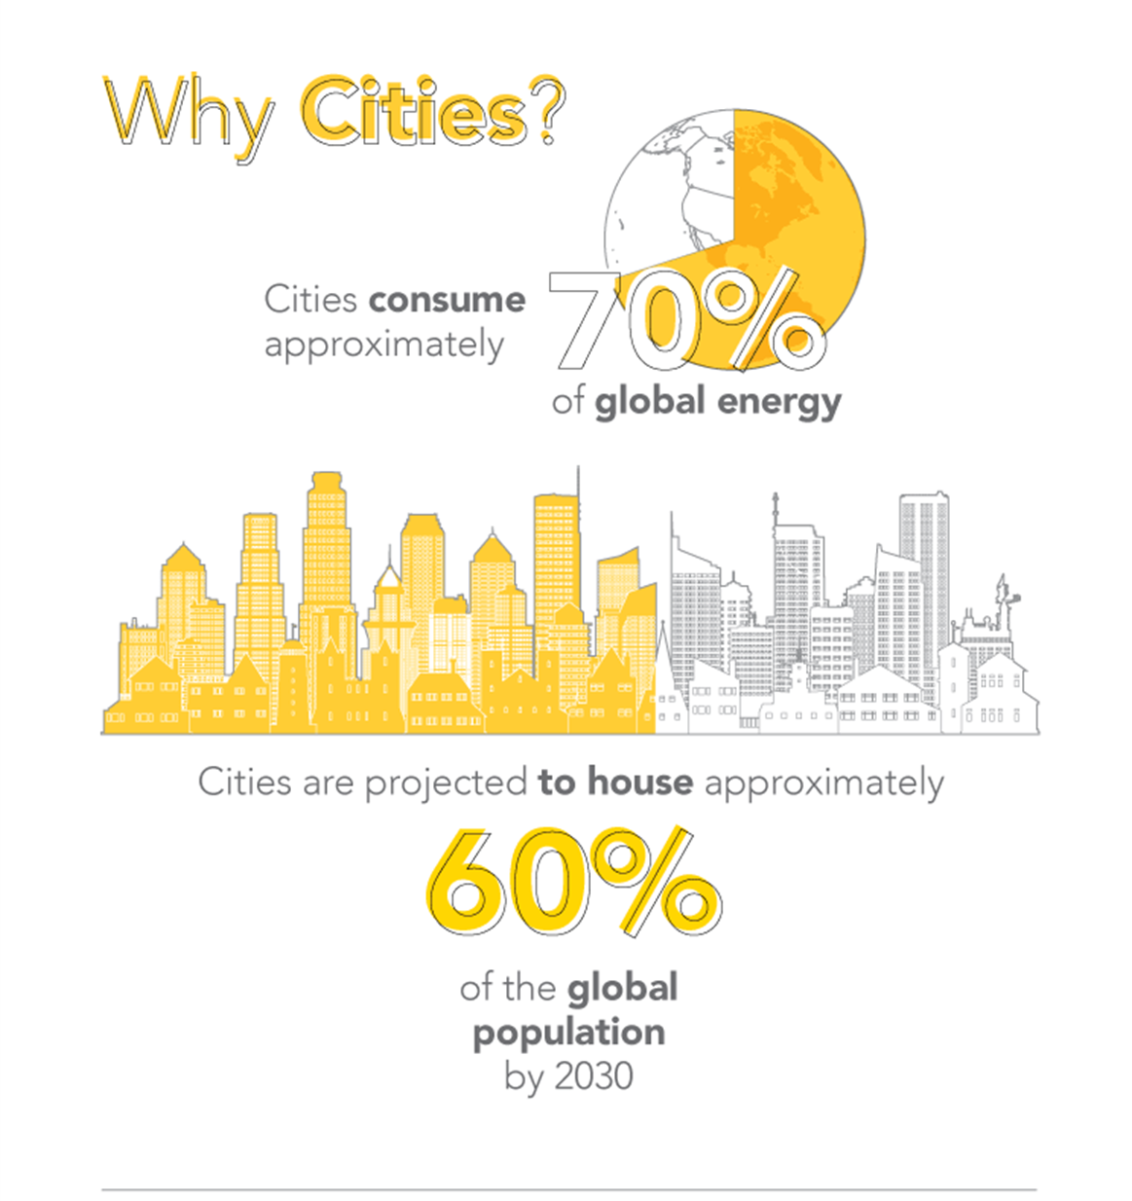
The Opportunity
U.S. spends $600 billion each year to power homes, plants, & buildings
Great opportunities in public, residential, commercial and industrial sectors
20% + savings is average
Create jobs, improve air quality, enhance competitiveness
Notes:
Cities contribute 70% of global CO₂ emissions and are the population and innovation centers within states. They are poised to impact CO₂ emissions through their capacity as asset owners, law makers, taxation authorities, and recognition providers. Many cities have already set CO₂ emissions reduction goals by as much as 80% by 2050 and are implementing portfolios of programs and policies to achieve their goals

Slide 5



Opportunity before Local Governments
Buildings: 37% savings potential
  “The incremental efficiency potential is greatest in local-level government buildings (260 trillion end use BTUs), principally because local government buildings…hold 62 percent of government floor space.”
Streetlights: 50% savings potential
  Nationally estimated potential of 238tBtu/yr.
Water systems: 15-30% savings potential
  Preliminary estimates of national water sector energy savings potential of 15.75-31.5 billion kWh
McKinsey & Company, Unlocking Energy Efficiency in the U.S. Economy, July 2009. 2010 U.S. Lighting Inventory; Adoption of Light-Emitting Diodes in Common Lighting Applications, Navigant, Revised May 2013. Energy Savings Forecast of Solid-State Lighting in General Illumination Applications, Navigant, August 2014. CEE Initiative Description: CEE National Municipal Water and Wastewater Facility Initiative. 2204.

Slide 6
DOE Resources, Tools, and Programs to Help Local Governments
Programs/Initiatives
Weatherization & Intergovernmental Programs Office (WIP)
The Cities Leading Through Energy Analysis and Planning (Cities-LEAP)
Clean Cities
Climate Action Champions
State and Local Energy Efficiency Action Network (SEE Action)
Better Buildings
  Better Buildings Challenge
  Better Buildings Accelerators
  Better Buildings Alliance Technology Campaigns
Resources/Tools
Standard Energy Efficiency Database (SEED) Platform
Building Performance Database
Building Energy Asset Scoring Tool
Federal Energy Management Program (FEMP) Resources
Best Practices in Energy Data Collection and Tracking in the Public Sector
Community Energy Strategic Planning Guide
Qualified Energy Conservation Bond Guide
Benchmarking and Transparency Policy and Program Impact Evaluation Handbook
Retro-commissioning for State and Local Governments (SEE Action fact sheet)
High-Performance Leasing for State and Local Governments (SEE Action fact sheet)
Strategic Energy Management for State and Local Governments (SEE Action fact sheet)
Notes:
Advanced Rooftop Unit Campaign
Interior Lighting Campaign
Lighting Energy Efficiency in Parking (LEEP) Campaign

Slide 7
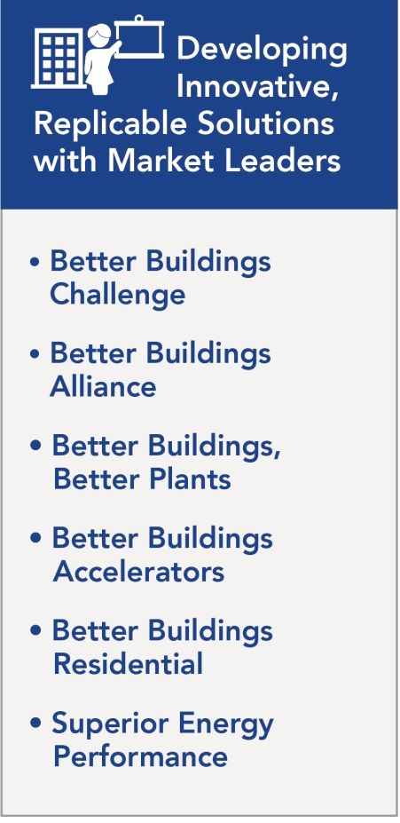

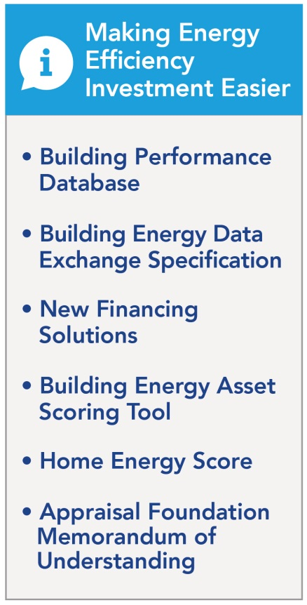
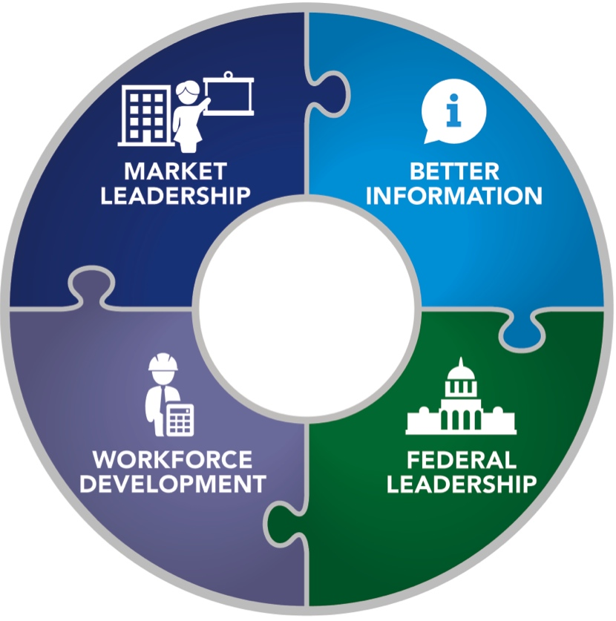
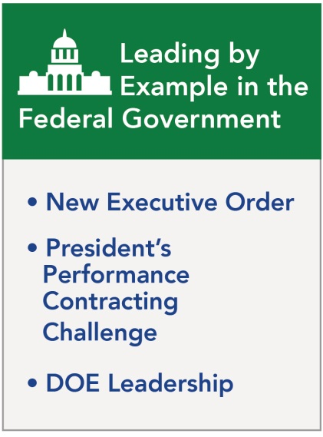
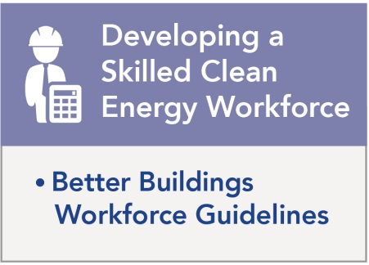

Slide 8




















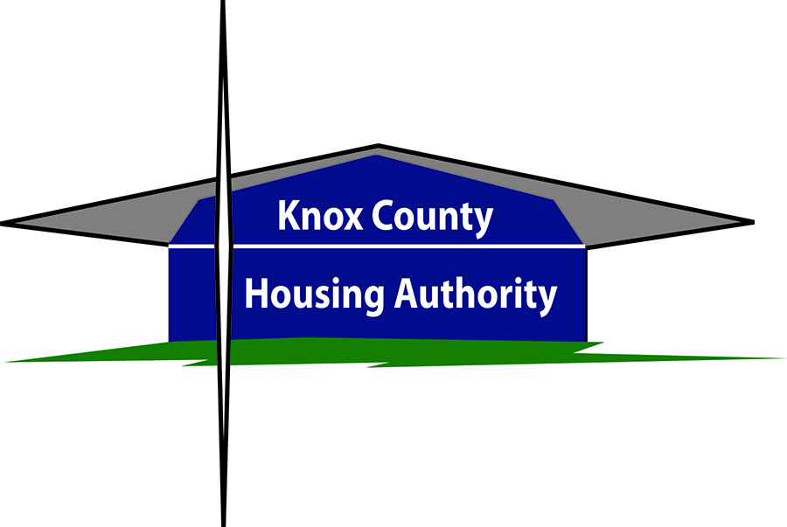































































































Better Building Challenge Partners & Allies
Notes:
Launched 2011, Now 250+ Partners & Allies
Commercial, Industrial, Public, Private
Represent:
3.5+ Billion Square Feet
$5+ Billion Private Financing
650+ Manufacturing plants
$4 B Federal Commitment
Goals
Make commercial, industrial buildings & multifamily housing 20%+ more efficient over 10 years
Save $80B+ annually for US organizations
Create American jobs, improve energy security, and mitigate impacts of climate change
How
Leadership
Results
Transparency
Best practice models
Recognition
Catalyzing action

Slide 9
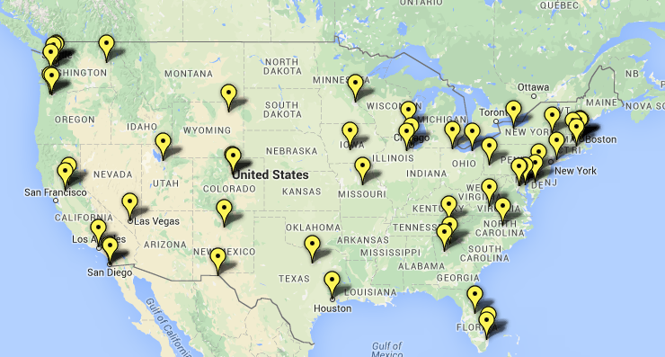
Better Buildings Challenge: Local Partners
Notes:
BBC Partners represent all regions of the country and a wide variety of sized communities - from Gillette, WY with 31,000 people to Los Angeles with 3.8 million people
Buildings reached through local government BBC Partners include airports, fire stations, libraries, city halls, courthouses, schools, office buildings, civic centers, fleet garages, museums, and wastewater treatment facilities.

Slide 10








Better Buildings Challenge: Florida Partners
Notes:
BBC Partners represent all regions of the country and a wide variety of sized communities - from Gillette, WY with 31,000 people to Los Angeles with 3.8 million people
Buildings reached through local government BBC Partners include airports, fire stations, libraries, city halls, courthouses, schools, office buildings, civic centers, fleet garages, museums, and wastewater treatment facilities.

Slide 11

Playbook: City of Beaverton
Real Time Energy Monitoring
Beaverton’s energy monitoring pilot program is one of the key strategies the city is using to help identify the highest impact opportunities for energy savings.
BARRIER
Lack of access to consistent and transparent building performance data; lack of employee awareness of energy efficiency opportunities
SOLUTION
Used real time energy monitoring to more accurately identify, prioritize, and implement low and no cost energy savings measures (ESMs) at two city facilities - the Main Branch Beaverton City Library and Beaverton City Hall
OUTCOME
The city is saving approximately $35,000 annually. The two buildings have achieved 23% and 15% energy savings respectively

Slide 12
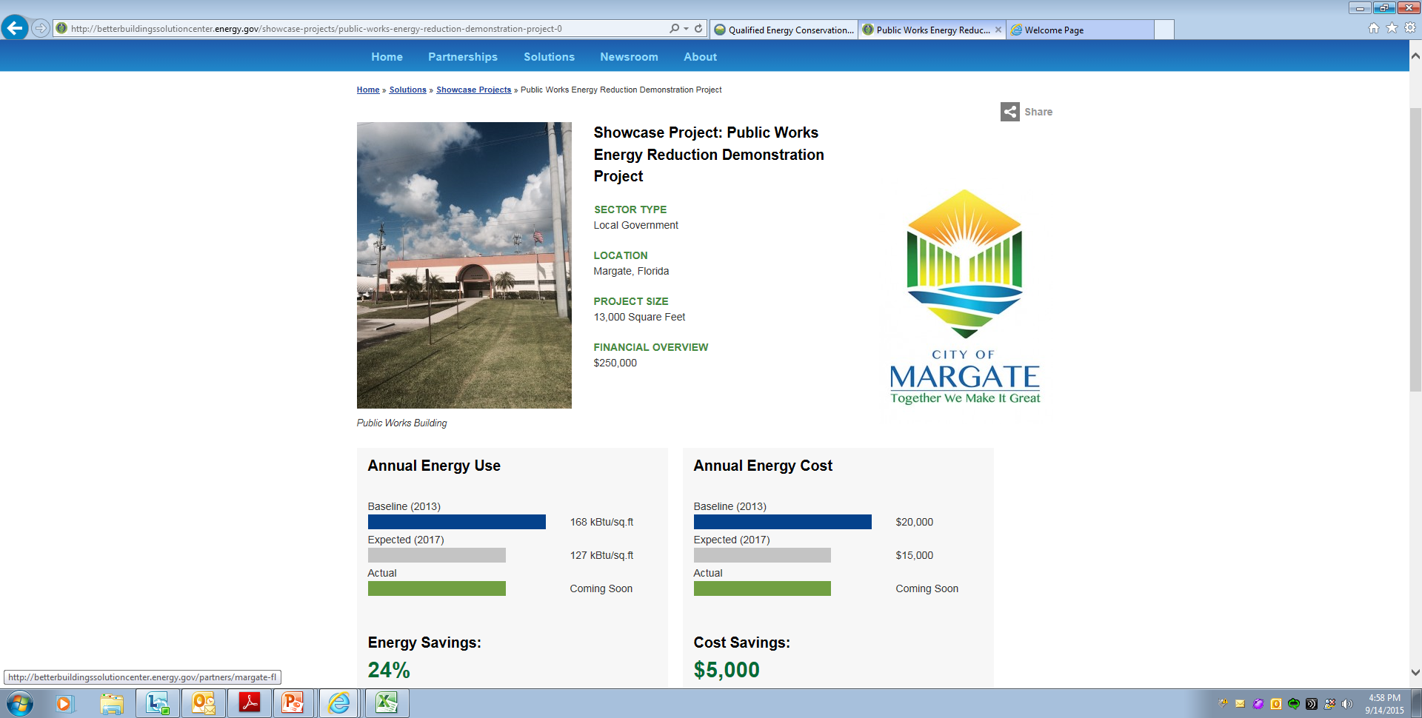
Showcase Project: City of Margate

Slide 13
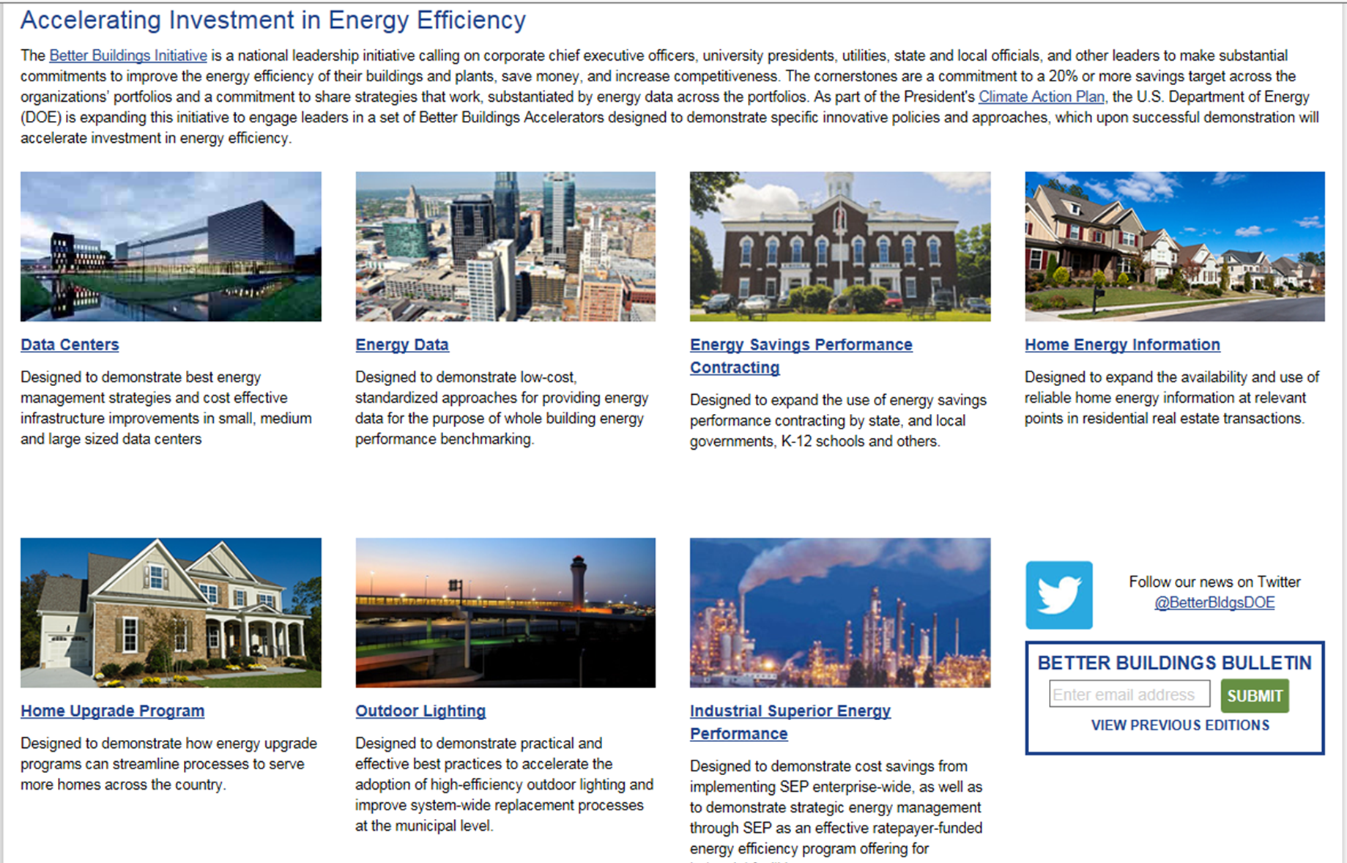
Better Buildings Accelerators
Notes:
Outdoor Lighting Accelerator
Energy Savings Performance Contracting Accelerator
Energy Data Accelerator

Slide 14
Critical Building Blocks
Develop a clean energy strategy
Design and implement best practices programs
Find a way to pay for clean energy efforts
Access and utilize energy data

Slide 15

Resources on Clean Energy Planning
Community Energy Strategic Planning Guide
Cities Leading through Energy Analysis and Planning (Cities-LEAP)
Better Buildings Implementation Models (Cleveland, Knoxville)
Develop a clean energy strategy
Notes:
The Cities Leading through Energy Analysis and Planning (Cities-LEAP) project delivers standardized, localized energy data and analysis that enables cities to lead clean energy innovation and integrate strategic energy analysis into decision making.
Cities-LEAP supports the widespread implementation of city-sponsored data-driven energy policies, programs, and projects that have the potential to drive a sea change in the national energy landscape. Through Cities-LEAP, cities will be able to:
Set climate or energy goals
Prioritize and implement energy strategies
See the impacts of potential climate or energy action plans
Learn from peers about city energy planning best practices
Get access to credible data and transparent, usable analytic methodologies
Make data-driven energy decisions.

Slide 16

Resources on Clean Energy Program Development
Better Buildings Showcase Projects (30 local government examples)
Better Buildings Outdoor Lighting Accelerator
Better Buildings Implementation Models (El Paso, Houston, Arlington, Beaverton, Atlanta, LA, DC)
Federal Energy Management Program (FEMP) Resources
Design and implement best practices programs

Slide 17

Resources on Funding and Financing
Better Buildings ESPC Accelerator
State and Local Solution Center Finance Page
Qualified Energy Conservation Bond Guide
Better Buildings Implementation Models (Pittsburgh, Hillsboro, Milwaukee)
Better Buildings Financial Allies
Find a way to pay for clean energy efforts

Slide 18

Resources on Energy Data
Best Practices in Energy Data Collection and Tracking in the Public Sector
Better Buildings Energy Data Accelerator
Cities Leading through Energy Analysis and Planning
Building Performance Database
Standard Energy Efficiency Database (SEED) Platform
Access and utilize energy data

Slide 19

To Access Resources
DOE’s State and Local Solution Center http://energy.gov/eere/slsc/state-and-local-solution-center
Better Buildings Solution Center
http://betterbuildingssolutioncenter.energy.gov/
State and Local Energy Efficiency Action
Network (SEE Action)
http://www4.eere.energy.gov/seeaction/
Commercial Buildings Resource Database
https://buildingdata.energy.gov/cbrd/
Better Buildings Summit
http://www1.eere.energy.gov/buildings/betterbuildings/summit/
Notes:
Just the tip of the iceberg, but we have selected five top places to go for resources at DOE. The next set of slides provide a visual representation of each of these five resources

Slide 20
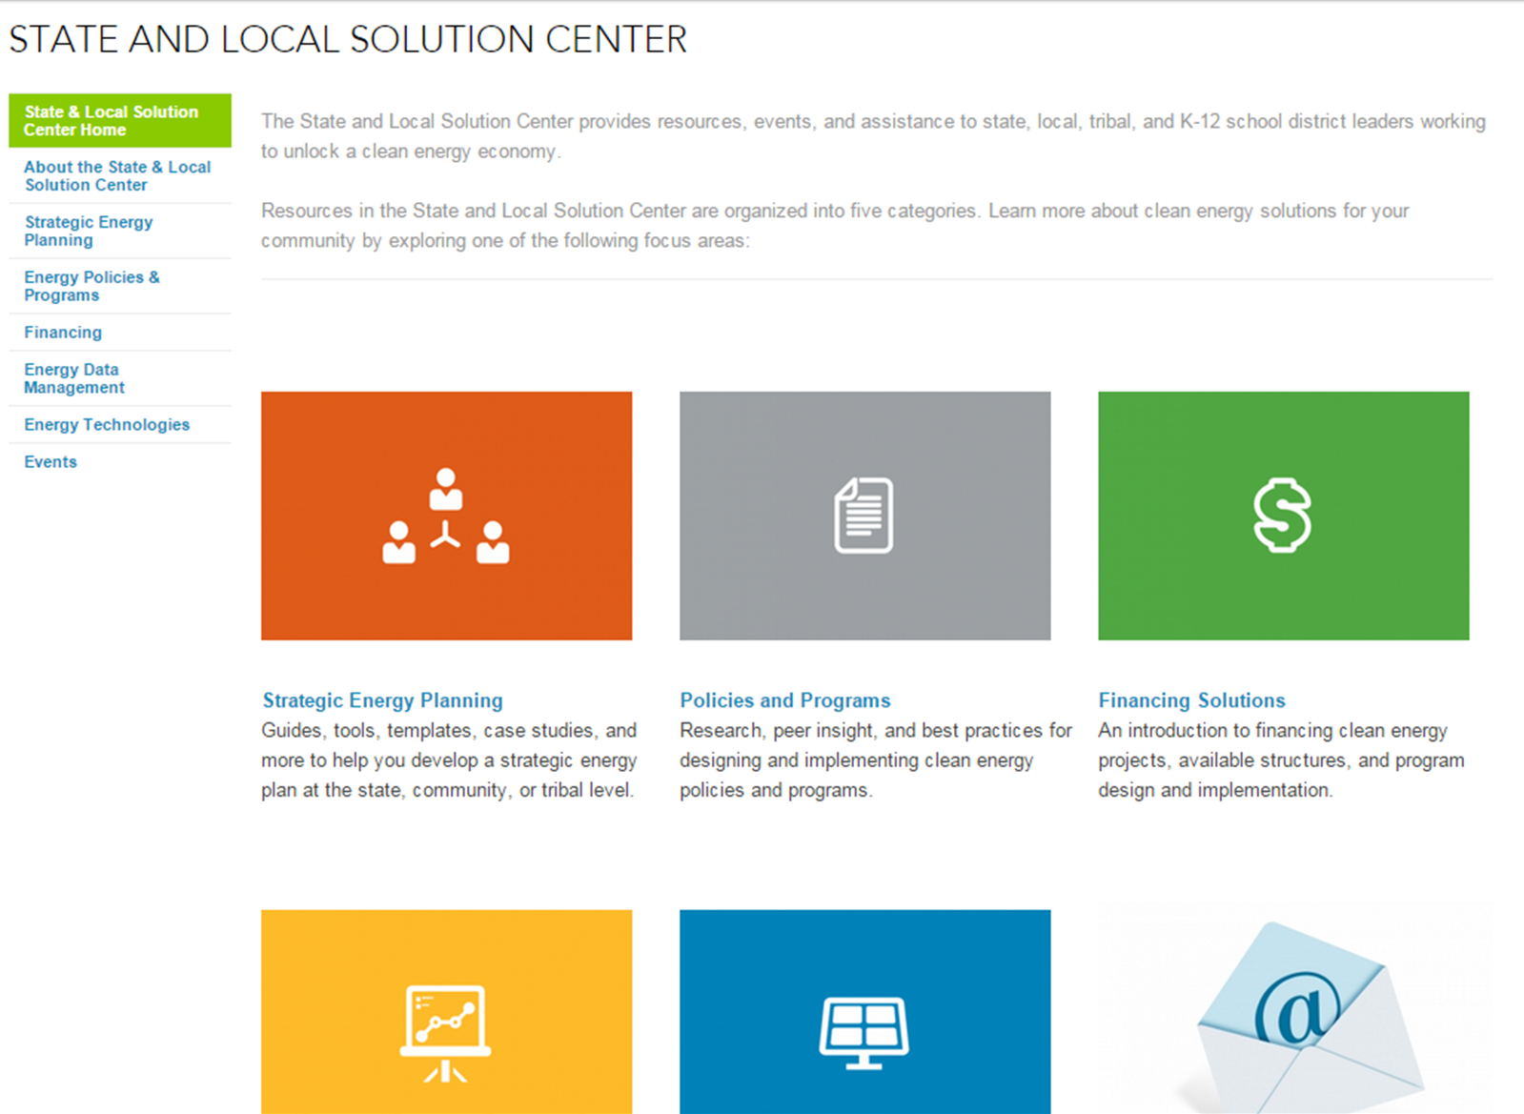
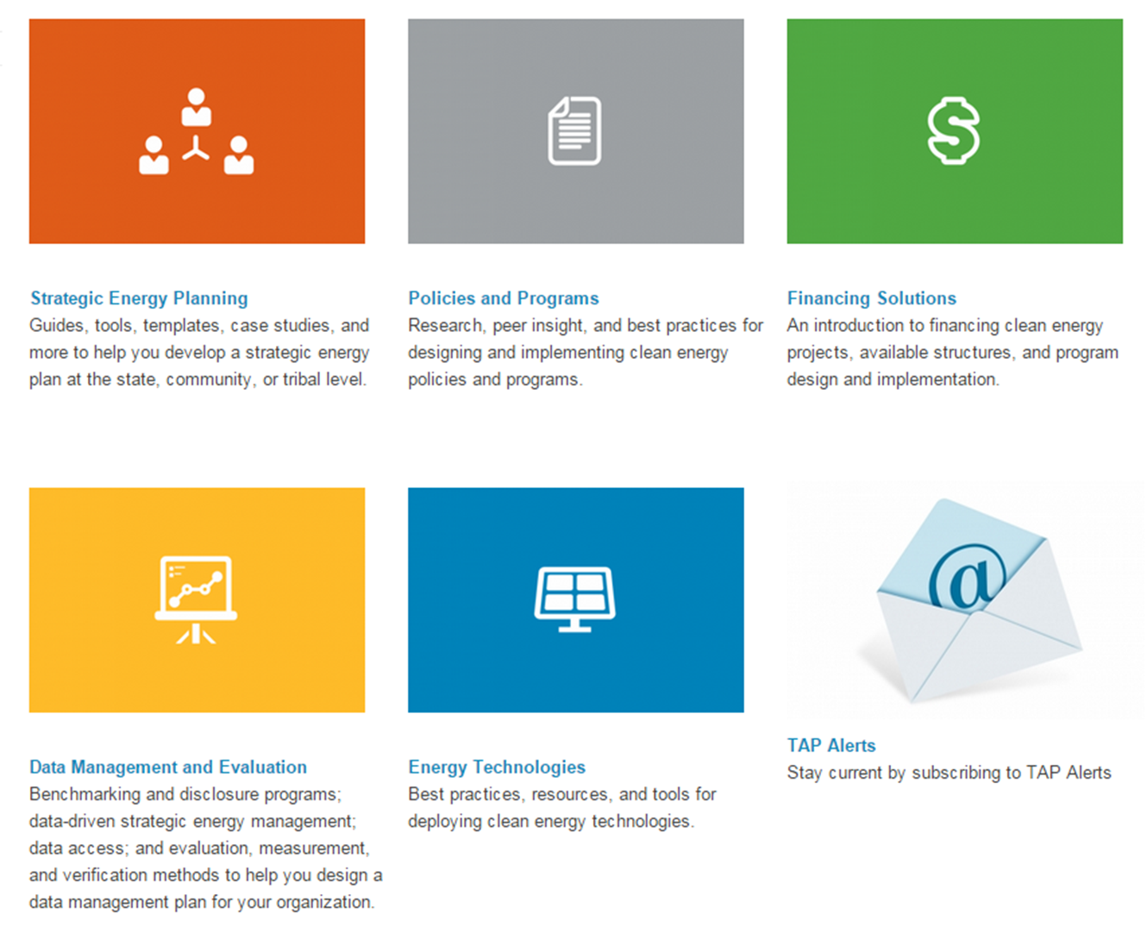
http://energy.gov/eere/slsc/state-and-local-solution-center

Slide 21
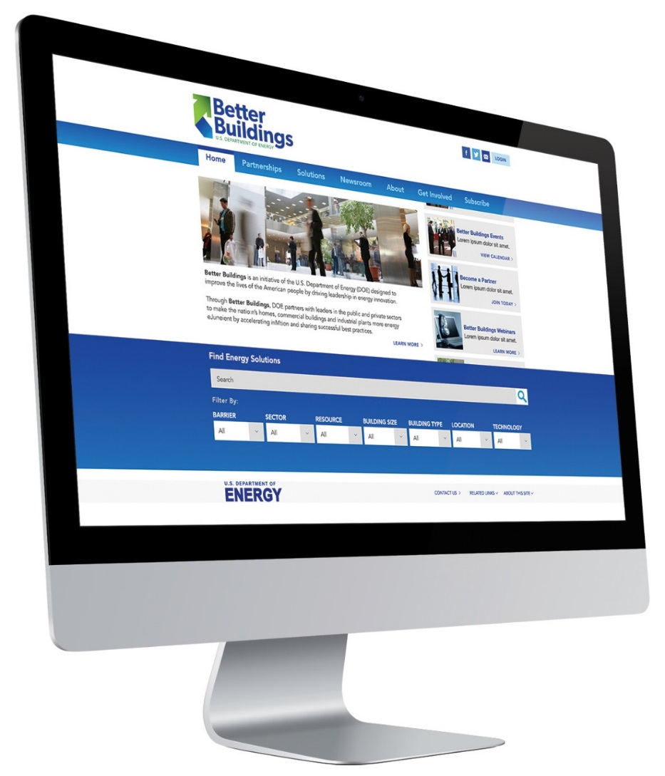
Better Buildings Solution Center
http://betterbuildingssolutioncenter.energy.gov/
125+ showcase projects
  Large and small buildings
  All sectors
  Specific building types
75+ implementation models (playbooks)
  Overcome barriers: finance, data, energy management, staff training, etc.
  Multi-faceted and applicable across sectors

Slide 22
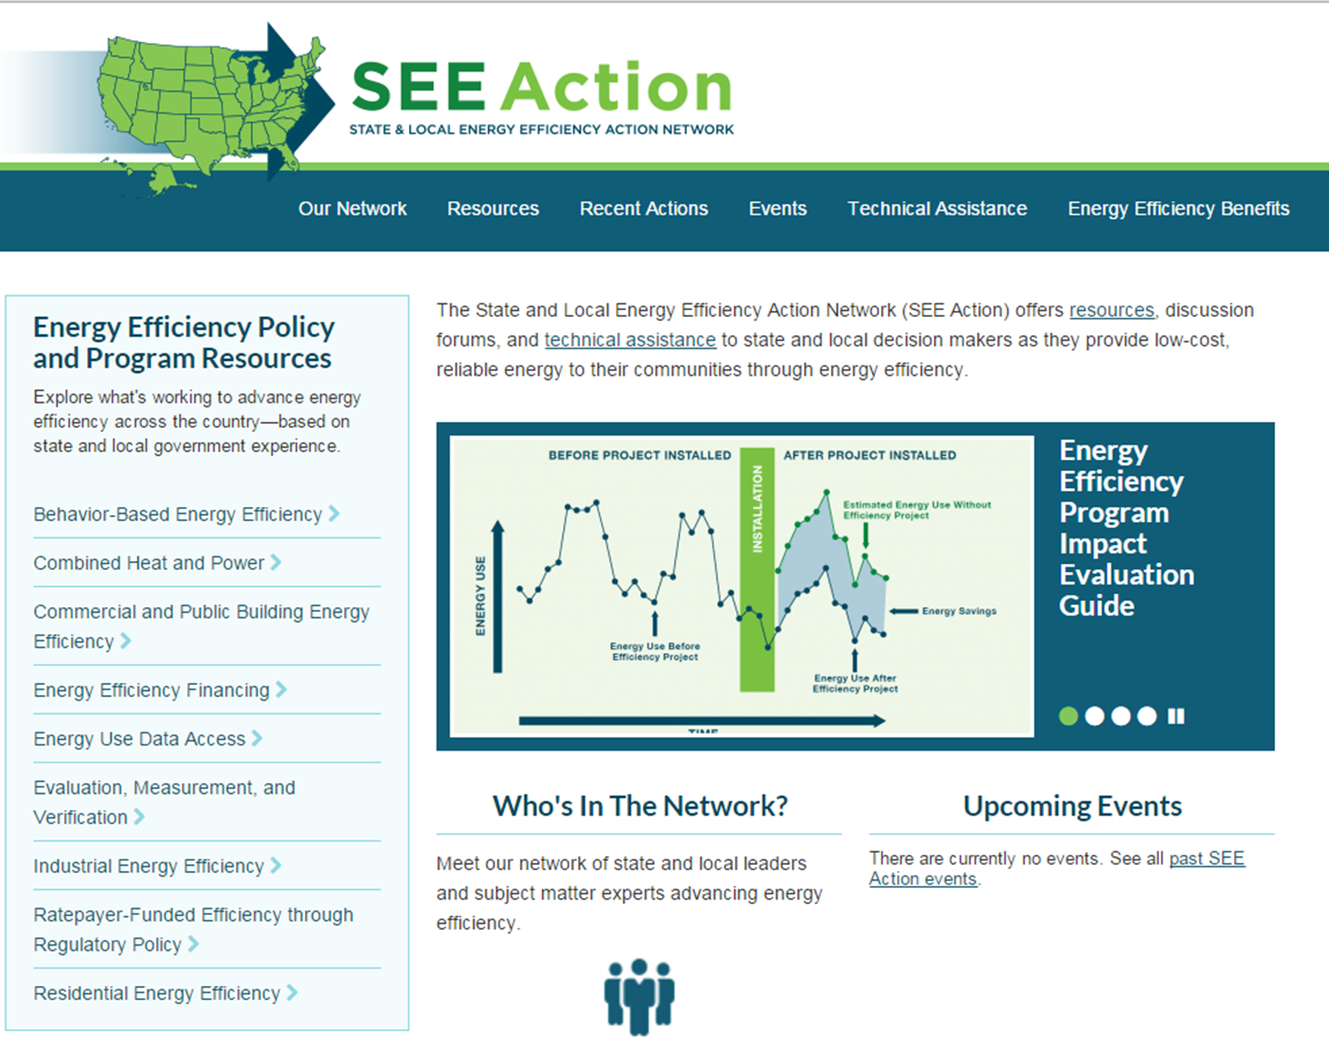
http://www4.eere.energy.gov/seeaction/

Slide 23
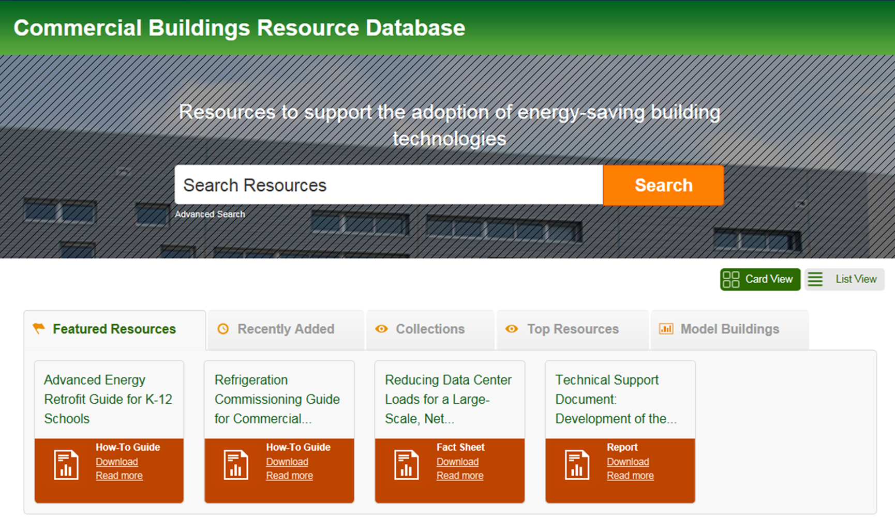
https://buildingdata.energy.gov/cbrd/

Slide 24

http://www1.eere.energy.gov/buildings/betterbuildings/summit/

Slide 25
Contact Information
Sarah Zaleski
Policy Advisor
U.S. Department of Energy
202-287-1892
Sarah.Zaleski@ee.doe.gov
Adam Guzzo
Policy Advisor
U.S. Department of Energy
202-287-1689
Adam.Guzzo@ee.doe.gov

