Slide 1

The Intention of our presentation is Expansion, Education and Powerful Partnerships
Linda Gancitano
Broward County Public Schools
Driftwood Middle School
linda.gancitano@browardschools.com
Elaine Fiore
Broward County Public Schools
Beachside Montessori Village
elaine.fiore@browardschools.com

Slide 2

How Low Can You Go ?
Energy Challenge

Slide 3
How Low Can Driftwood Middle School Go?

Slide 4
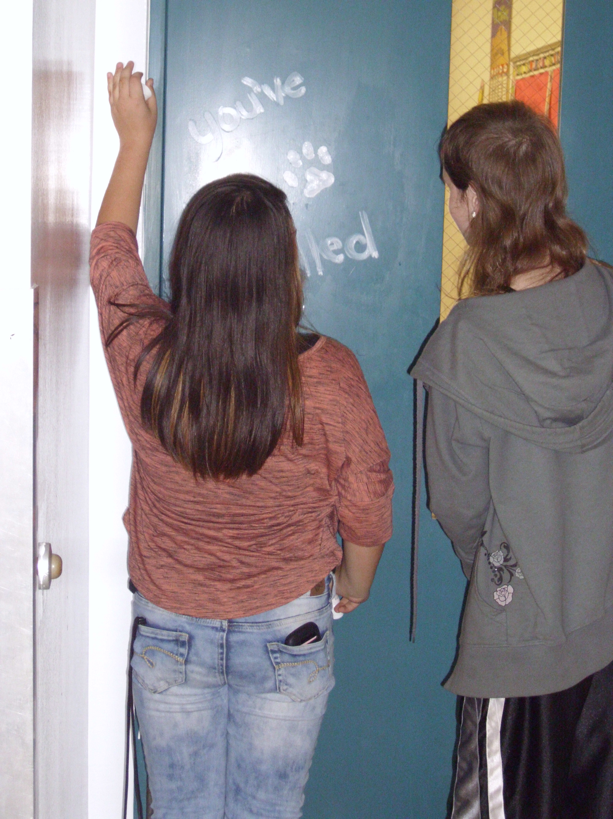

Driftwood Middle
Energy Reduction Initiatives
  DMS Chillers-Energy Team
  Energy Audits
  You’ve been Chilled!
  Track data
  Posters, morning and afternoon announcements
  Chill the Polar Bear Mascot

Slide 5
Broward Schools Energy Savings
2013-14 Challenge | 2014-15 Challenge
1 month | 3 months
64 Schools Participate | 82 Schools Participate
380,000 KWH Reduction | 1,502,000 KWH Reduction
$ 34,255 Cost Savings | $ 143,587 Cost Savings
577,676 lbs. CO2 emissions reduced | 2,283,275 lbs. CO2 emissions reduced

Slide 6
Contests and Themes to
Change Behavior
Buy in from staff – Incentive Program
  How Low Can You Go? Energy Challenge
  Are You S.E.K.C? –Stopping Excessive Kilowatt Consumption
  H.E.R.O Bracelets- Helpful Energy Resource Officer
  Lists favorable behaviors
  Incentives
  Recognition
  Social Media
  Pledge

Slide 7
Future Possibilities:
*Tri-County School Districts-
125+schools participate in the HLCYG
  *Local Businesses-Pilot Year
  10+ Businesses(DHL, Embraer)
  *Every NBA Team sponsors surrounding schools districts in the HLCYG in reducing CO2

Slide 8
Broward County Public Schools
Environmental Conservation
Utility Management Department
Partnership between facilities and key players
Energy Tools for Schools
Utility Management Department
Facilities manages ALL schools energy
  “Turn It Off” district emails- custodians, building managers

Slide 9
“The greatest threat to our planet is the belief that someone else will save it.”
- Robert Swan

