Slide 1
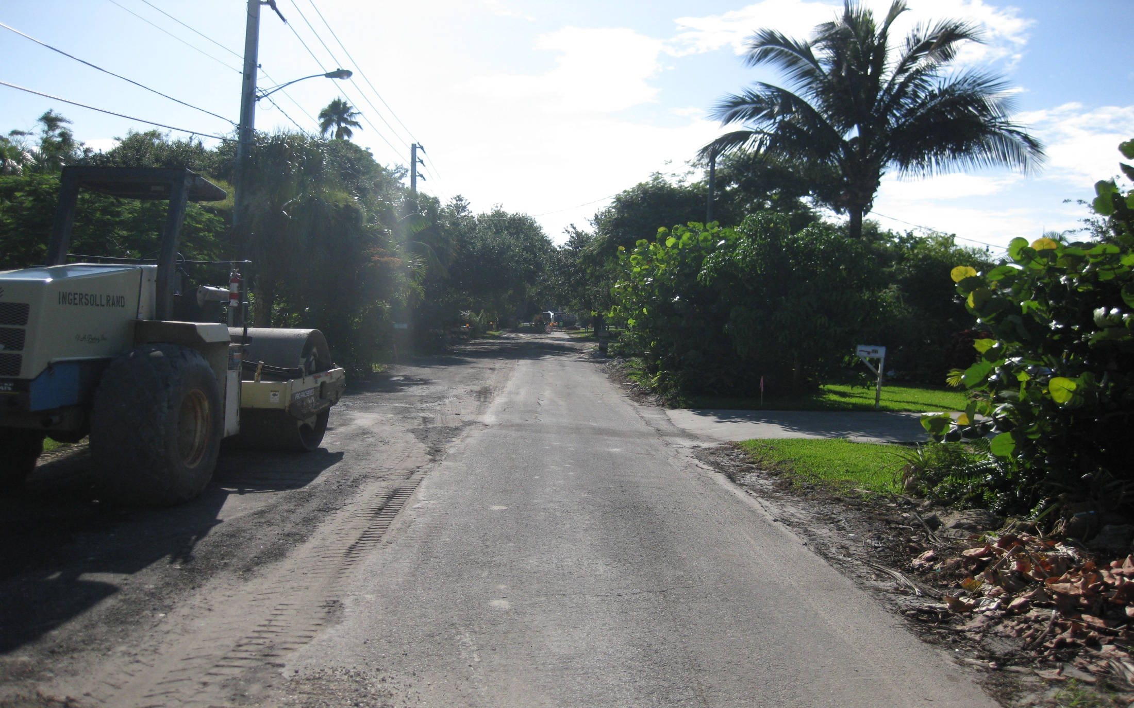
Resilient Stormwater Management in Southeast Florida – Financing Strategies Toward Sustainable Stormwater Systems
January 22, 2015

Slide 2
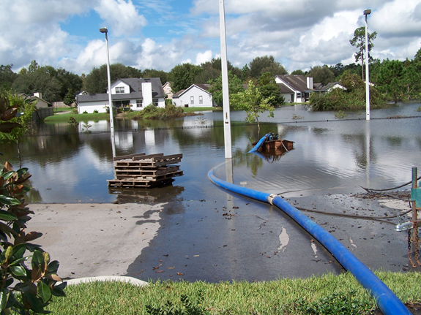
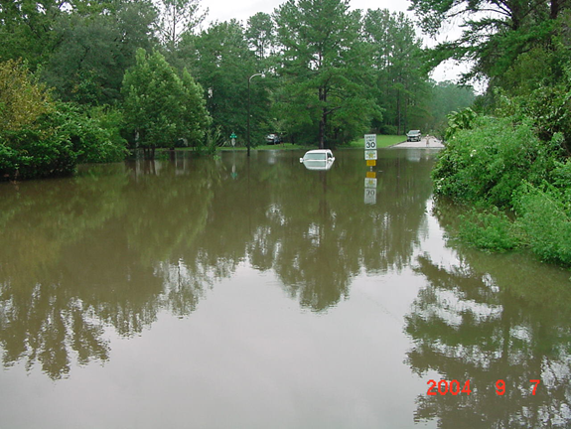
Needs for a Stormwater Management Program
Flood Protection
Water Quality
Regulatory
NFIP/CRS
TMDLs
NPDES
Development Review
Operation and Maintenance
Emergency Response
Planning and Monitoring

Slide 3
Stormwater Funding Options Comparison
Funding Option | Sufficient | Dedicated | Not Limited | Fair / Equitable | Recurring
Ad Valorem Taxes | ✓ |  | ✓ |  | ✓
Gas Tax |  | ✓ |  |  | ✓
Sales Tax |  | ✓ |  |  | ✓
MSTU | ✓ | ✓ | ✓ |  | ✓
MSBU | ✓ | ✓ | ✓ | ✓ | ✓
Stormwater Assessment Fee | ✓ | ✓ | ✓ | ✓ | ✓
Stormwater Utility | ✓ | ✓ | ✓ | ✓ | ✓
General Obligation Bond | ✓ | ✓ | ✓ |  | ✓
Grants and Appropriations |  | ✓
Loans |  | ✓
Impact Fees |  | ✓
Notes:
Municipal Services Taxing Unit - Tax based on property value
Municipal Services Benefit Unit - Special assessment independent of property value

Slide 4
Stormwater Utilities in Florida
403.0893, F.S. authorizes implementation of a stormwater utility
Approximately 175 in Florida
Florida Stormwater Association
Formerly Florida Association of Stormwater Utilities
Implementation Manual
Education and advocacy

Slide 5
Benefits of a Stormwater Utility
Dedicated funding source
Increased grant funding and bonding opportunities
Improved Community Rating System
Improves planning and operations
Users pay based on the degree to which they use the stormwater system or derive benefit

Slide 6
Stormwater Grants
Federal Emergency Management Agency
Relates to flood protection only
Hazard Mitigation Grant Program
Pre-Disaster Mitigation
Flood Mitigation Assistance
Others
Highly competitive
HMPG requires major disaster declaration
Notes:
National Fish and Wildlife Foundation
Five Star and Urban Waters Restoration Grant Program
Florida Recreation Development Assistance Program and Land and Water Conservation Fund
EPA Urban Small Waters

Slide 7
Stormwater Grants
SFWMD Cooperative Funding Program
Two-part application process
Stormwater
Alternative water supply
Water conservation
Designs and studies are eligible
Other grants come off the top
Break into yearly phases
50-60% match usually required
Not for flood protection only

Slide 8
Stormwater Grants
SFWMD Cooperative Funding Program
District Strategic Plan Priorities and Regional Water Supply Plan Strategies
Environmental, resource, and/or community benefits
Cost effectiveness
Project readiness
Innovation
Continuation phase of a previously funded project
Past performance

Slide 9
Stormwater Grants
SFWMD Cooperative Funding Program
Areas discharging to an impaired water body (includes TMDLs and BMAPS)
Areas within a Surface Water Improvement and Management Plan
Areas identified within another regional plan or appropriate management plan
Projects identified in a local government stormwater master plan
Projects that have major watershed benefits such as regional solutions

Slide 10
Stormwater Grants
Section 319 and TMDL Grants
Impaired waters
At least at the 60% design phase
Permitted or the permit has been scheduled for approval at the next meeting
Includes storm event monitoring to determine the actual load reduction
Construction completed within 3 years
Used for construction
Minimum of 50% match, with at least 25% by the local government.

Slide 11
Stormwater Grants
Section 319 and TMDL Grants
Impairment status
Cost effectiveness based on the cost per pound of nutrient removed
Inclusion of a robust educational component
Dedicated funding source for stormwater management, such as a stormwater utility fee
Estimated load reduction
Percentage of local matching funds

Slide 12
Questions

