Slide 1
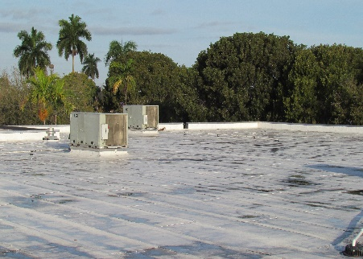
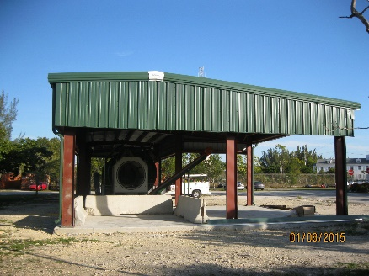
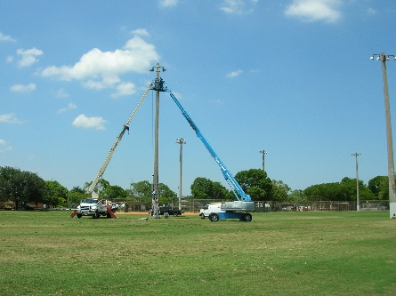
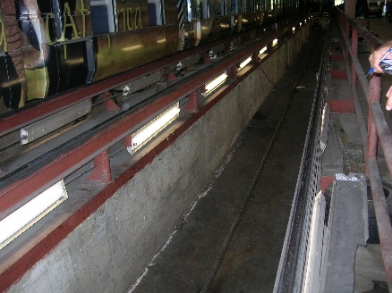
Energy Performance Contracting:
Financing Energy Performance Improvement Projects
Patricia Gómez PE, CEM, LEED AP
Office of Sustainability
Miami-Dade County Planning Division
Regulatory and Economic Resources Department
September 2015

Slide 2
EPC: financing
A survey conducted in 2011 of County capital departments showed that most departments
lack a dedicated budget for energy performance improvements.
Challenge: Retrofits are typically funded with capital dollars, but…
capital dollars are usually committed to other projects;
capital dollars are often scarce so projects are competing with other priorities; and
the approval process for requesting new capital dollars is time and resource intensive and requires Board approval.
Solution:
Fund energy efficiency investments with Energy Performance Contracting (EPC)!

Slide 3
EPC: program description
EPC is a financing mechanism that enables the County to execute energy performance improvement projects and water efficiency projects at no capital expense.
Through a State of Florida contract (Chapter 489.145 of the State of Florida Statues), MD County can access the services of 10 companies known as Energy Services Companies or “ESCOs” to provide energy savings improvements for all county facilities.
The State Vendor Pool includes: Ameresco, Inc., BGA, Inc., Chevron Energy Solutions, Energy Services Group, Inc., FPL, Honeywell, Johnson Controls, Inc., Siemens Industry, Inc., Schneider Electric Buildings Americas, Inc., and Trane.
Miami-Dade County has operated a successful EPC program since 1998.
EPC Services Resolution (R-740-08)
Passed in 2008
Established a $40M “Energy Savings Program” for a 5-year period
Waived competitive bidding in favor of the State’s pre-qualified vendor pool
Does not require Board of County Commissioner approval for contracts under $1 M

Slide 4
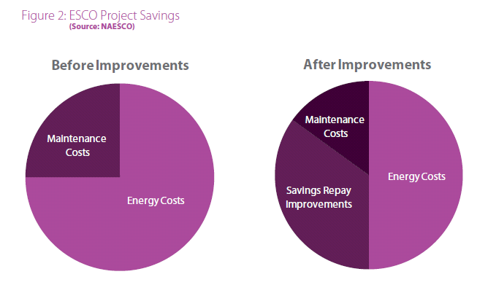
EPC: advantages
EPC projects are implemented through tax-exempt municipal-lease
purchase agreements or other third party financing.
Advantage: Using a lease-purchase agreement finances the purchase of assets, yet the repayment can be treated as an operating expense allowing project savings to accrue to the same budget from which the payments are made.
Savings free up $$$ for further investments in energy efficiency and feed the cycle of continuous energy management.

Slide 5
EPC: process
ESCO selected via RFP or RFQ
Investment Grade Audit
Sufficient savings opportunities identified*
Projects pay for themselves
ESCO’s work backed by a guarantee that project savings will cover the customer’s debt service or lease payments.
ESCO conducts turnkey energy performance improvement projects
*The Statues also allow savings that can be achieved from avoided maintenance as credits towards the viability of a project. The County, however, has chosen to allow credits only on maintenance presently performed by outside contractors, and from avoided parts or supplies purchases.

Slide 6
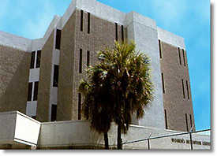
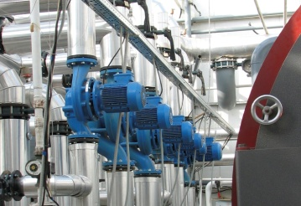
EPC: completed projects
Data & Operations Buildings
• Back-up Generation
Building infrastructure ECMs
Miami International Airport
• 900 ton chiller plant & AHUs
• 4000 ton chiller for Terminal
Downtown Loop
• Implement Variable Flow CHW System
• Connected New Building to CHW Loop
2000
2001
2002
2007
2000
2004
2006
Women's Detention Center
• New chiller
Downtown Buildings & Courthouses
Multiple ECMs
Solved plumbing leak issues
Correctional Facilities & Court Houses
• Traditional ECMs • Created chilled water mini loop
Miami International Airport
• New lighting systems
• Doubled light levels

Slide 7
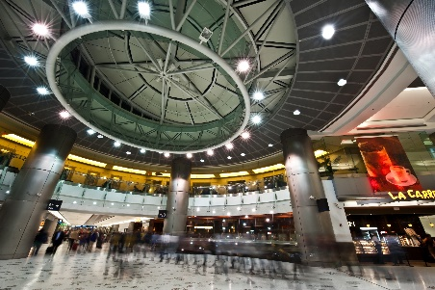
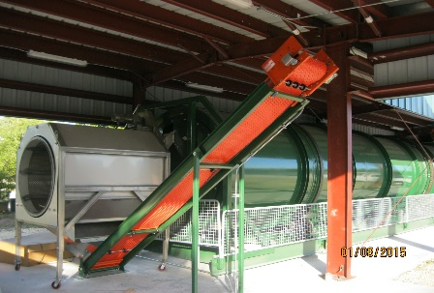
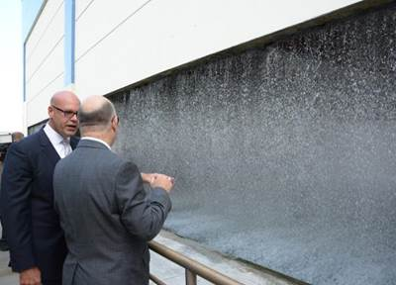
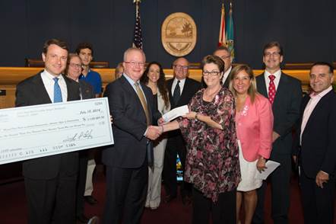
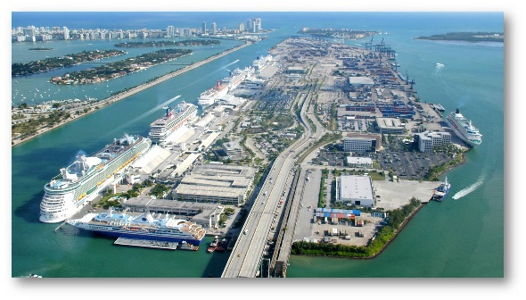
EPC: completed projects
Miami International Airport
• Lighting
Parks and Open Spaces
• Composter, lighting, HVAC upgrades, etc.
Miami International Airport
• $32 million A/C and ventilation upgrades
• Reduce water consumption 28 million gallons
2012
2015 - present
2010
2013
2014
Chiller Plant Expansion and Downtown Loop Interconnection
The upgraded system serves 12 major facilities in Downtown Miami
PortMiami
• Parking garages and maintenance building

Slide 8
EPC: benefits
Completed EPC projects until 2010 saved the County over 64,535,600 kWh of electricity and 71,729,250 gallons of water per year; that’s equivalent to $5 million per year.
No cost to departments until the County proceeds with implementation.
2. ISD coordinates project and serves as liaison between ESCOs and County departments.
3. ESCOs guarantee savings for the entire “payback” period of the project. If measure does not achieve guaranteed savings, County is refunded. Any savings above those estimated are kept by the County.
4. Equipment purchased through this program tends to be the best available quality in the market.
5. Savings achieved from avoided maintenance can serve as credits towards the viability of a project.
MIA lighting phase 2 and Chiller Expansion are expected to reduce electrical usage by an additional 6,315,000 kWh and gross annual expenses by an additional $774,300.
PROS project is expected to generated $12 million in savings over the next 15 years.
MIA Sustainability Project is expected to reduce 28 million gallons of water every year and 35 million kWh per year

Slide 9
Patricia Gómez
Office of Sustainability
Planning Division
Dept. of Regulatory & Economic Resources
Miami-Dade County
gomezp@miamidade.gov
(305) 375-4775

