Slide 1
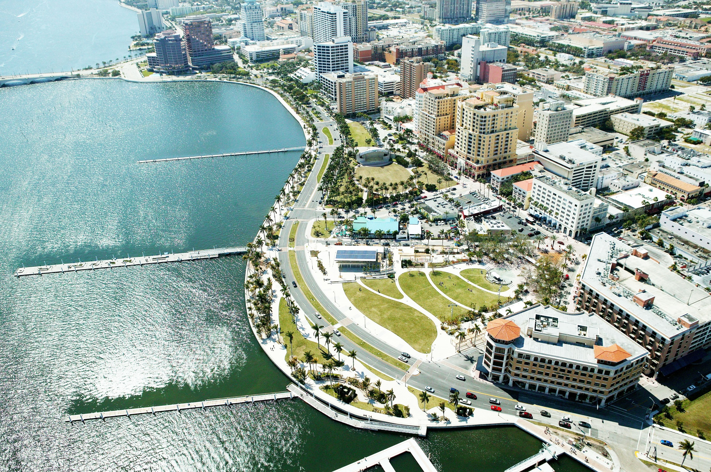

Slide 4
Greenhouse Gas Reduction Targets
City Facilities and Operations
83,000
Metric Tons
of CO₂e
19%
32%
37%

Slide 5
Sustainability
Timeline

Slide 6
Notes:
A total of over one thousand mayors, including West Palm Beach Mayor Lois J. Frankel, have now signed the U.S. Conference of Mayors Climate Protection Agreement – a landmark pledge for mayors across the country to take bold action to significantly reduce carbon emissions in cities. Mayor Frankel signed the agreement in 2007.

Slide 7
Sometimes, It’s Not Easy Being Green…
Aging Facilities & Infrastructures
Declining Tax & Revenue Base
Demand for Greater Services with Fewer Resources
. . . Commitment to Leading a Sustainable Community

Slide 8
Performance Contracting
Energy Efficiency and Capital Improvement Projects that are funded entirely through resulting energy and operational savings:
Encouraged by Florida Statute §489.145
Reduce Utility Consumption Between 20% - 40%
Reduce Greenhouse Gas Emissions (GHG)
No Upfront Cost / Positive Cash Flow Over Term
Guaranteed Performance

Slide 9
State Energy Performance Contract
Energy Services Coalition
Energy Performance Contracting Manual
www.energyservicescoalition.org
Selecting an ESCO
Choose an ESCO on State Contract
Department of Management Services – State Term Contractors
Bid/RFQ (WPB chose this route)

Slide 10
Steps
Establish Need
Procurement
Investment Grade Energy Audit
Choose ECMs (Energy Conservation Measures)
Trust but Verify
Contract
Implement
M&V
Celebrate!

Slide 11
Retaining a Third Party Verifier
Technical Review Contract Development Support
M&V Review General Navigation of the process
Prescribed Deliverables
Review investment-grade audits and recommended ECM’s, with estimated costs and savings
Annual energy savings, pre-installation baselines, reasonableness of economic valuation of savings
Review details of M&V Plan
Advise on project costs and cash flow analysis
Technical assistance to legal counsel (i.e. contract)

Slide 12
Contract Opportunities
Direct Purchasing – Considerable tax savings on big ticket high volume purchases within the contract.
Procurement Timing – Direct purchases may require a separate bid/RFP process.
Environmental Credits – Potential for future revenue due to avoided GHGE’s
Tax Credits – Typically a 50/50 split between the local government and ESCO.
.

Slide 13
Performance Guarantee & Measurement & Verification
Annual Savings Verification Report Each Year of Term
M&V Procedures Follow the International Performance Measurement & Verification Protocol (IPMVP)
Any Shortfall in Savings will be Paid by ESCO
Guarantee may be Backed by a Third-Party Issued Energy Savings Bond

Slide 14
West Palm Beach Project
City Wide EECBG and Guaranteed Energy Savings Performance Contracts
Reduce Utility Consumption & Expense Across City
Support Achievement within the City’s Sustainability Action Plan Goals
Fund Needed Work to Alleviate Strained Capital Budgets
Implement Leading Technologies Such As LED Street Lighting

Slide 15
Energy Performance Contract
$11,000,000
Estimated Savings over 15 Years
$6.8M
Starting Funds
Energy Performance Contract
Additional Funds
Due To:
LED Technology Cost Reduction
Energy Conservation Measure Changes
Lower Than Initially Anticipated Financing Rate
City Owned
Streetlight
High Efficiency
Lighting Retrofits
Indoor
Energy
Retrofits
$4.2M
$1.6M
$1M
Streetlight LED Retrofits
$700k
IT Department
Upgrades
$300k
Notes:
! Would have reduced time not payments.
At a 2.5% interest rate, it was cheap money. So when we ended up with extra.. We chose to spend it instead of giving it up..

Slide 16
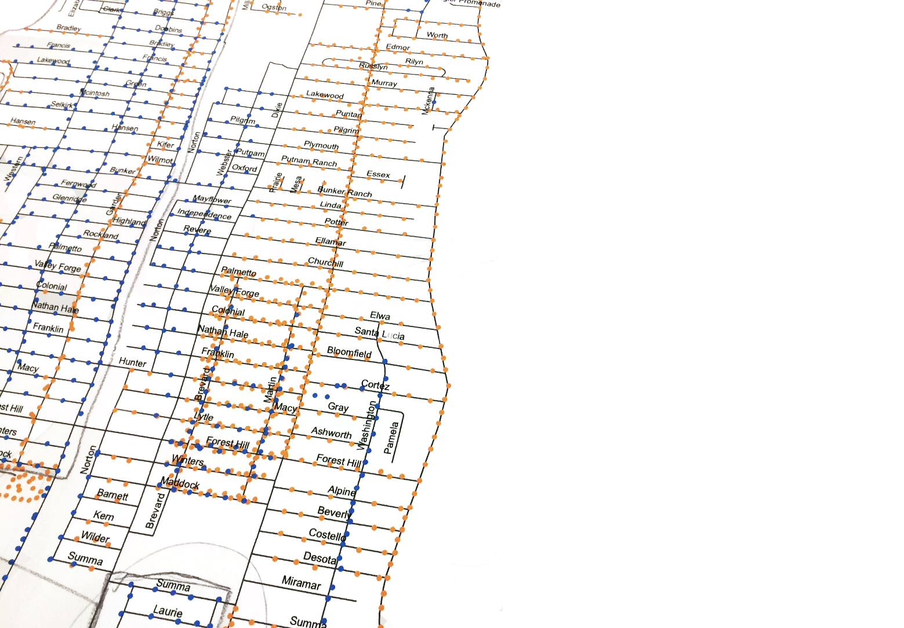
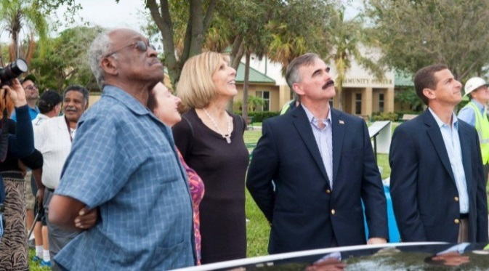
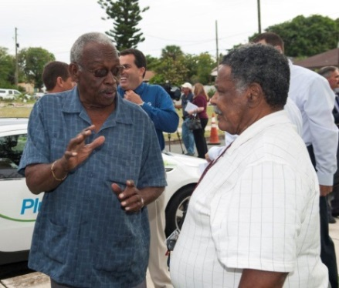
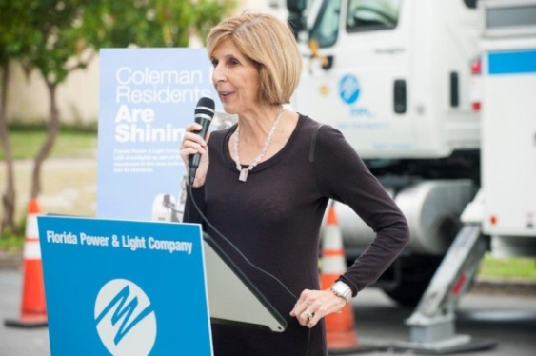
High Efficiency Streetlight Retrofits
6,700 Streetlights Retrofitted with High Efficiency Lights
$223,000
Estimated Annual Electricity Savings

Slide 17
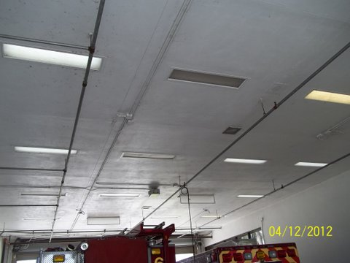
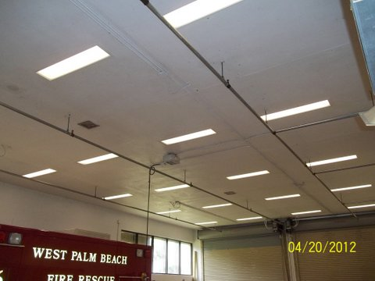
Facility Lighting
Upgrade of Facility Lighting Systems with a Combination High Efficiency Fluorescent, LED, and Induction Lighting Systems with Occupancy Controls at 15 City Facilities
$94,137 in Annual Energy and Maintenance Savings
35% Reduction in Energy Consumption
Longer Equipment Life
Improved Lighting
Quality

Slide 18
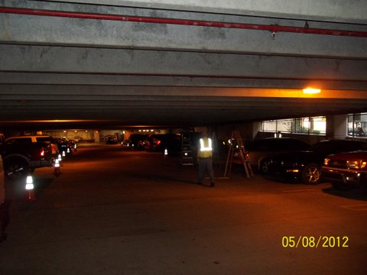
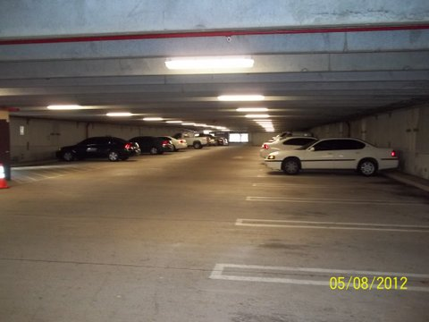
Parking Garage Lighting
Scope
Upgrade or Replacement of Garage Lighting Systems with a Combination High Efficiency Fluorescent, Lighting Systems and Automated Controls at 3 City Garages
$84,358 in Annual Energy/Maintenance
Savings
Longer Equipment Life
Increased Light Levels to
Meet Current Codes

Slide 19
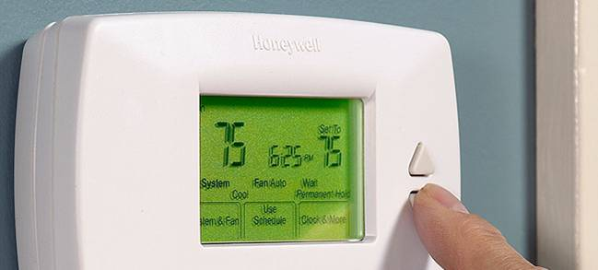
HVAC & Controls Upgrades
Scope
Various HVAC System Upgrades and Adjustments Including New Programmable Thermostats, Improved Controls Programming, and General Maintenance Procedures to Enhance Efficiency and Performance at 21 City Facilities
$8,180 in Annual Energy and Maintenance Savings
Improved Comfort
Extended System Life

Slide 20
Make It Easier
Get Full Understanding and Buy In Up Front
Central Maintenance Departments are Easier
Individual Meters are Best
Watch Your Attic Stock – Use Warranties
Know Your Streetlights/Roads
Third Party Verifier
Make Sure 1st Debt Service Payment Is After Savings
Watch Technology Changes
Check SIRs (Savings To Investment Ratio)
Have final Sign Off When All ECMs Are Complete

Slide 21
