Slide 1


Integrated Approach to Quantifying the Effects of Climate Change on Water Resources and Coastal Infrastructure in Urban Miami-Dade County
Eric D. Swain, Ph.D.
US Geological Survey
Virginia Walsh, Ph.D., P.G.
Miami-Dade Water and Sewer Department

Slide 2
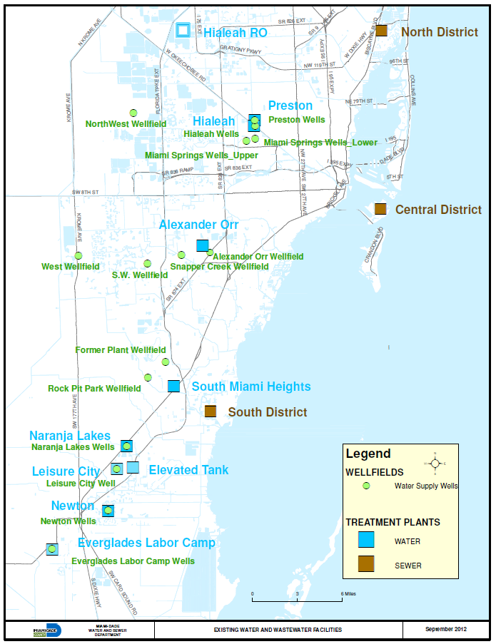
Miami-Dade
Water and Sewer Department Water & Wastewater
Treatment Facilities
Northwest
Wellfield
& Wellfields
Miami Springs
Wellfields
West
Wellfield
& Wellfield
Snapper Creek
Wellfield
South West
Wellfield
& Wellfield
& Wellfield
& Wellfield
& Wellfield
& Wellfield
Wellfields

Slide 3
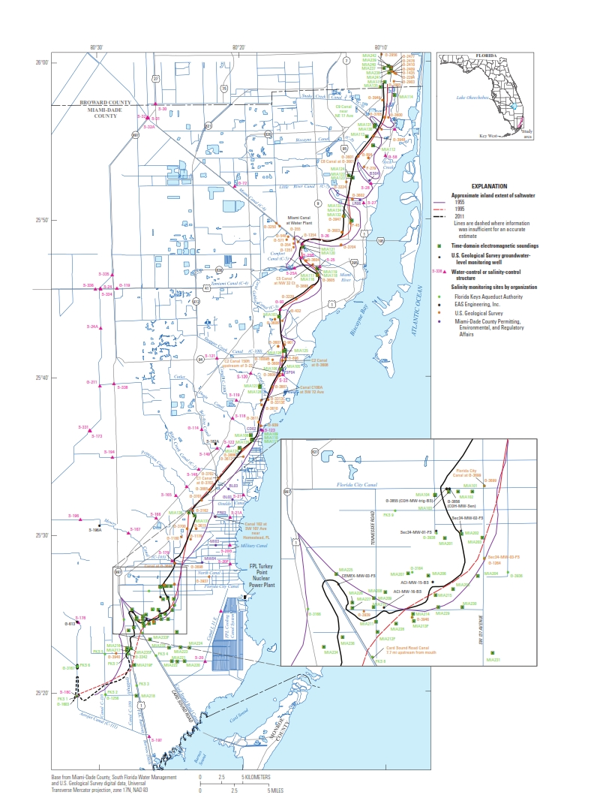
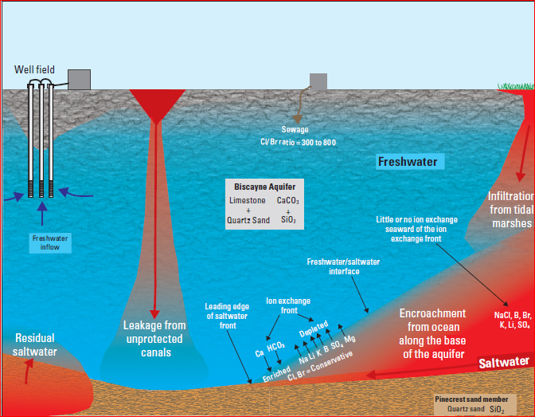
Miami-Dade County in Cooperation with the US Geological Survey has one of the most technically advanced monitoring network for Salt Water Intrusion in the World

Slide 4
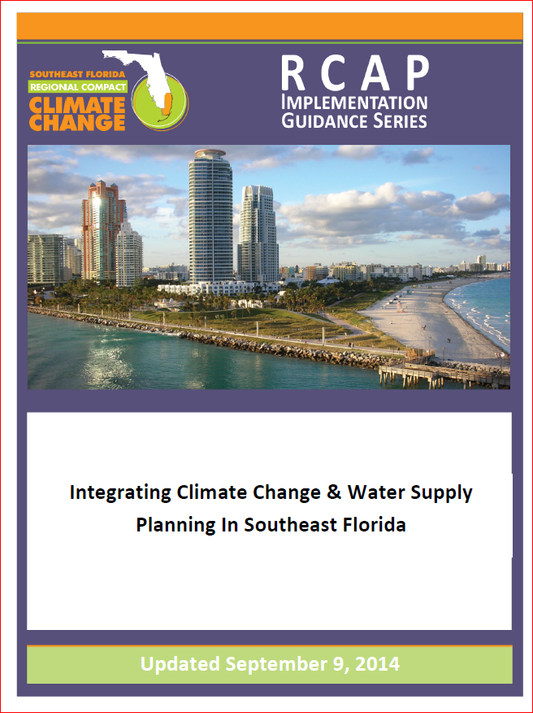
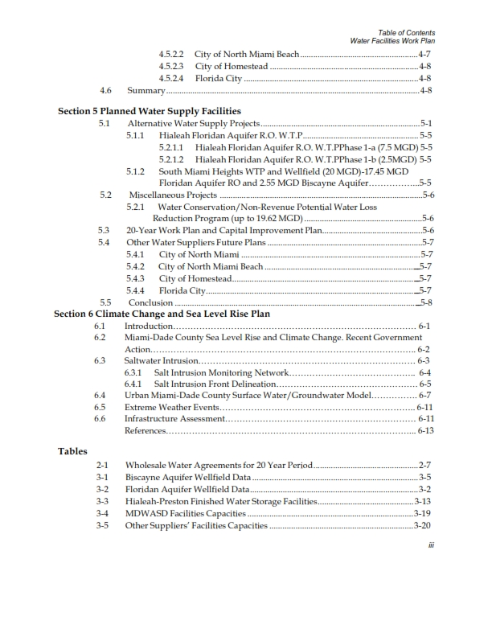
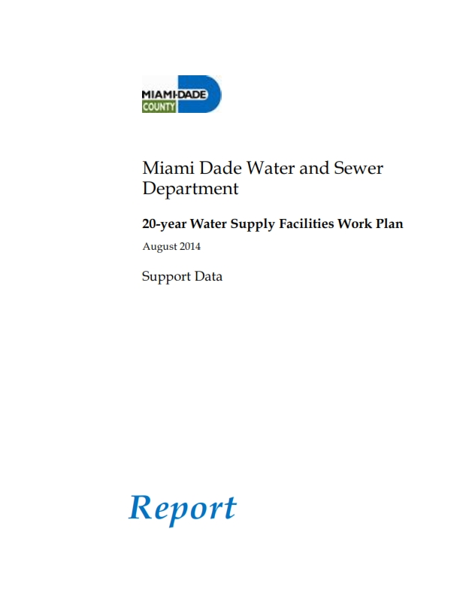
Climate change and SLR assessment is now a critical component of Water and Sewer Department (WASD) planning

Slide 5
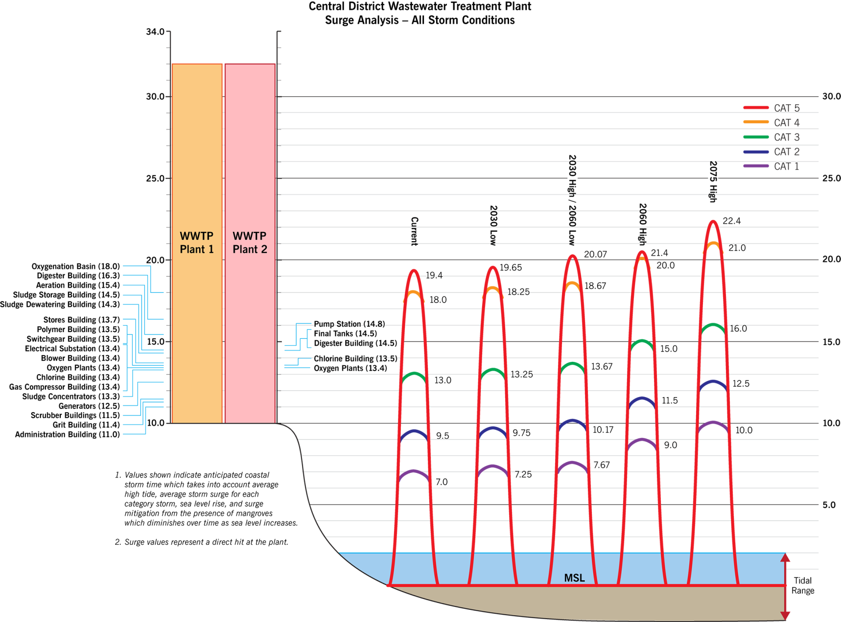

CDWWTP Storm Tide Analysis
CDWWTP is in
Flood Zone AE (10)

Slide 6

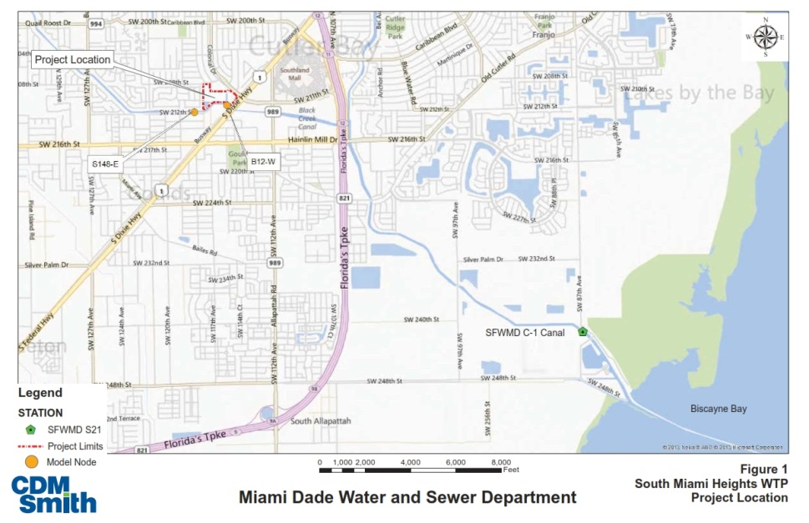
Effective Water Treatment Plant operations require proper control of flooding from both stormwater and tidal sources
1) background information on the site stormwater and tidal conditions
2) projections of potential increases in sea levels
3) potential ranges of effects on the WTP stormwater management system, and site grading considerations and access for proper operations.
S-21 salinity control structure
SLR based on USACE guidance document 50 year:
0.57, 1.05, 2.55 ft
Results: Designed at 9 ft NAVD
  Well above peak stage of C-1 Canal for a 100-year rainfall event at existing tide levels and the high projections of SLR

Slide 7
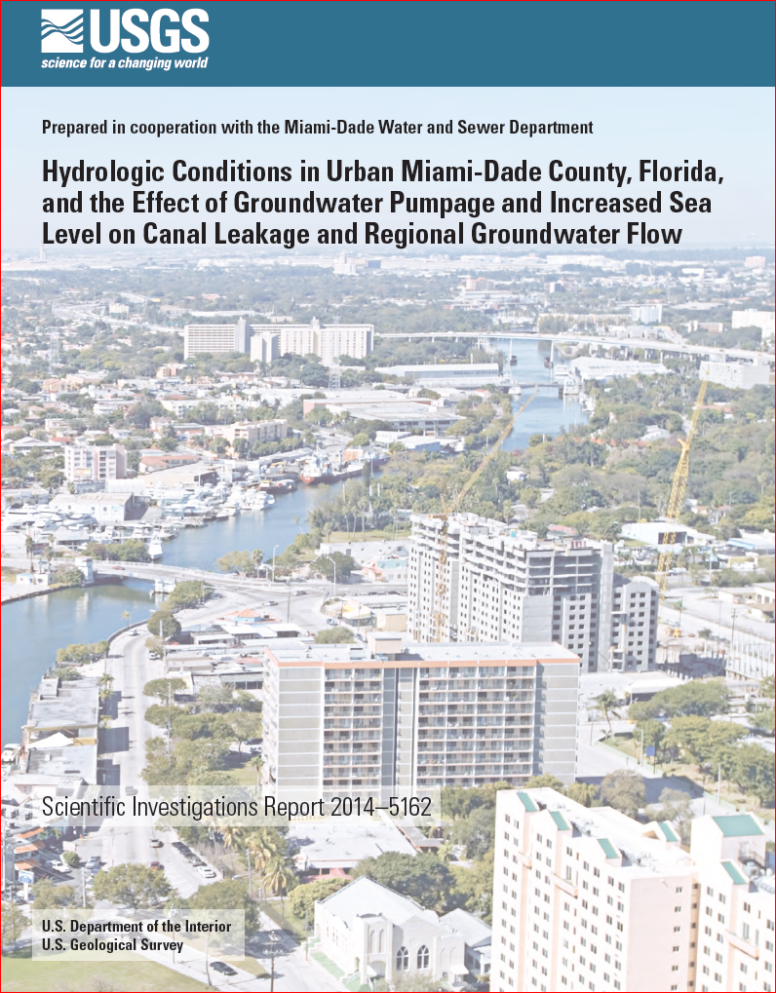
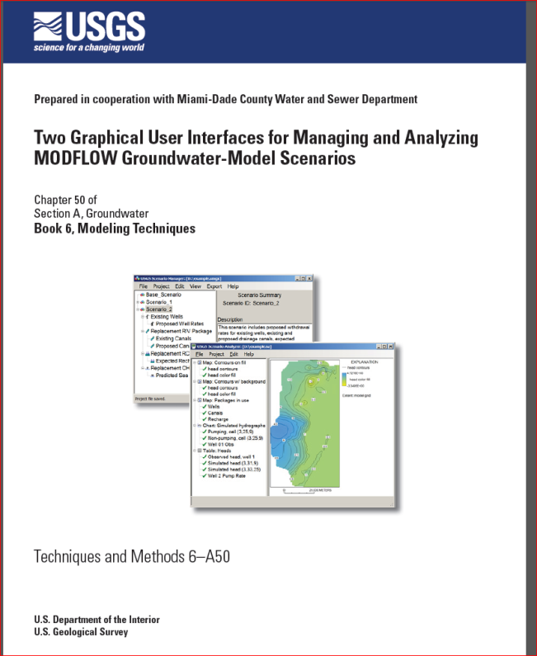
http://pubs.er.usgs.gov/publication/sir20145162
http://pubs.usgs.gov/tm/6a50/

Slide 8
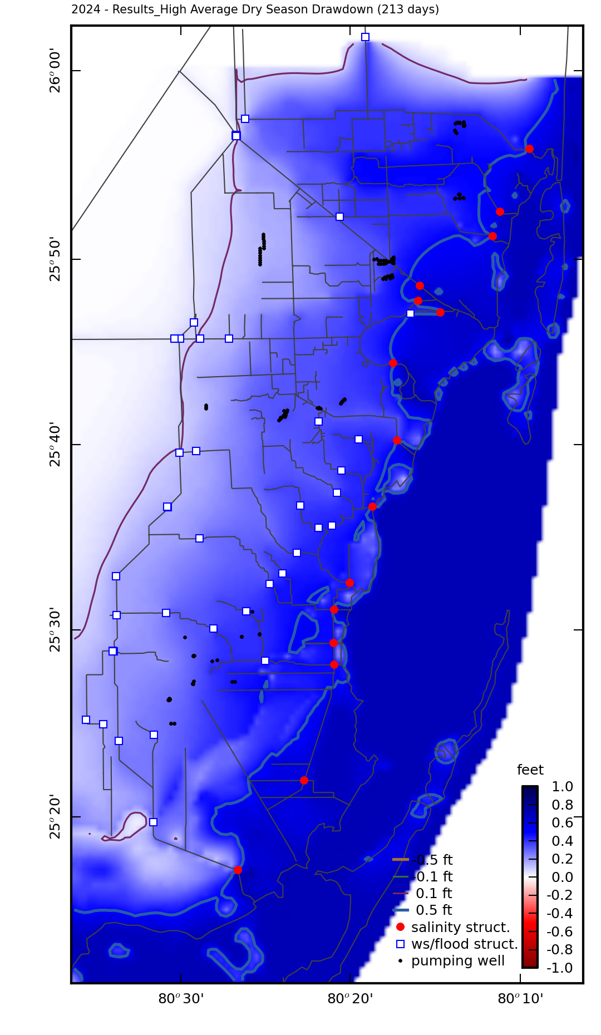
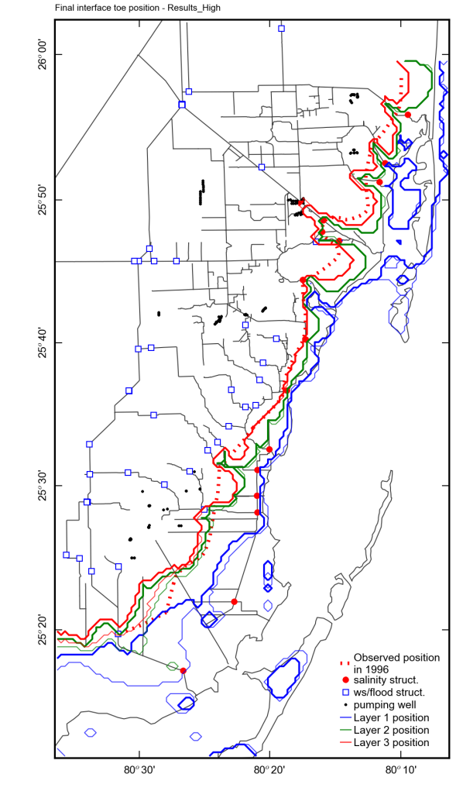
Average water-table drawdown and interface position
Increased sea level
Scenario 2

Slide 9
Miami-Dade
Water and Sewer Department Water & Wastewater
Treatment Facilities
Northwest
Wellfield
& Wellfields
Miami Springs
Wellfields
West
Wellfield
& Wellfield
Snapper Creek
Wellfield
South West
Wellfield
& Wellfield
& Wellfield
& Wellfield
& Wellfield
& Wellfield
Wellfields

Slide 10
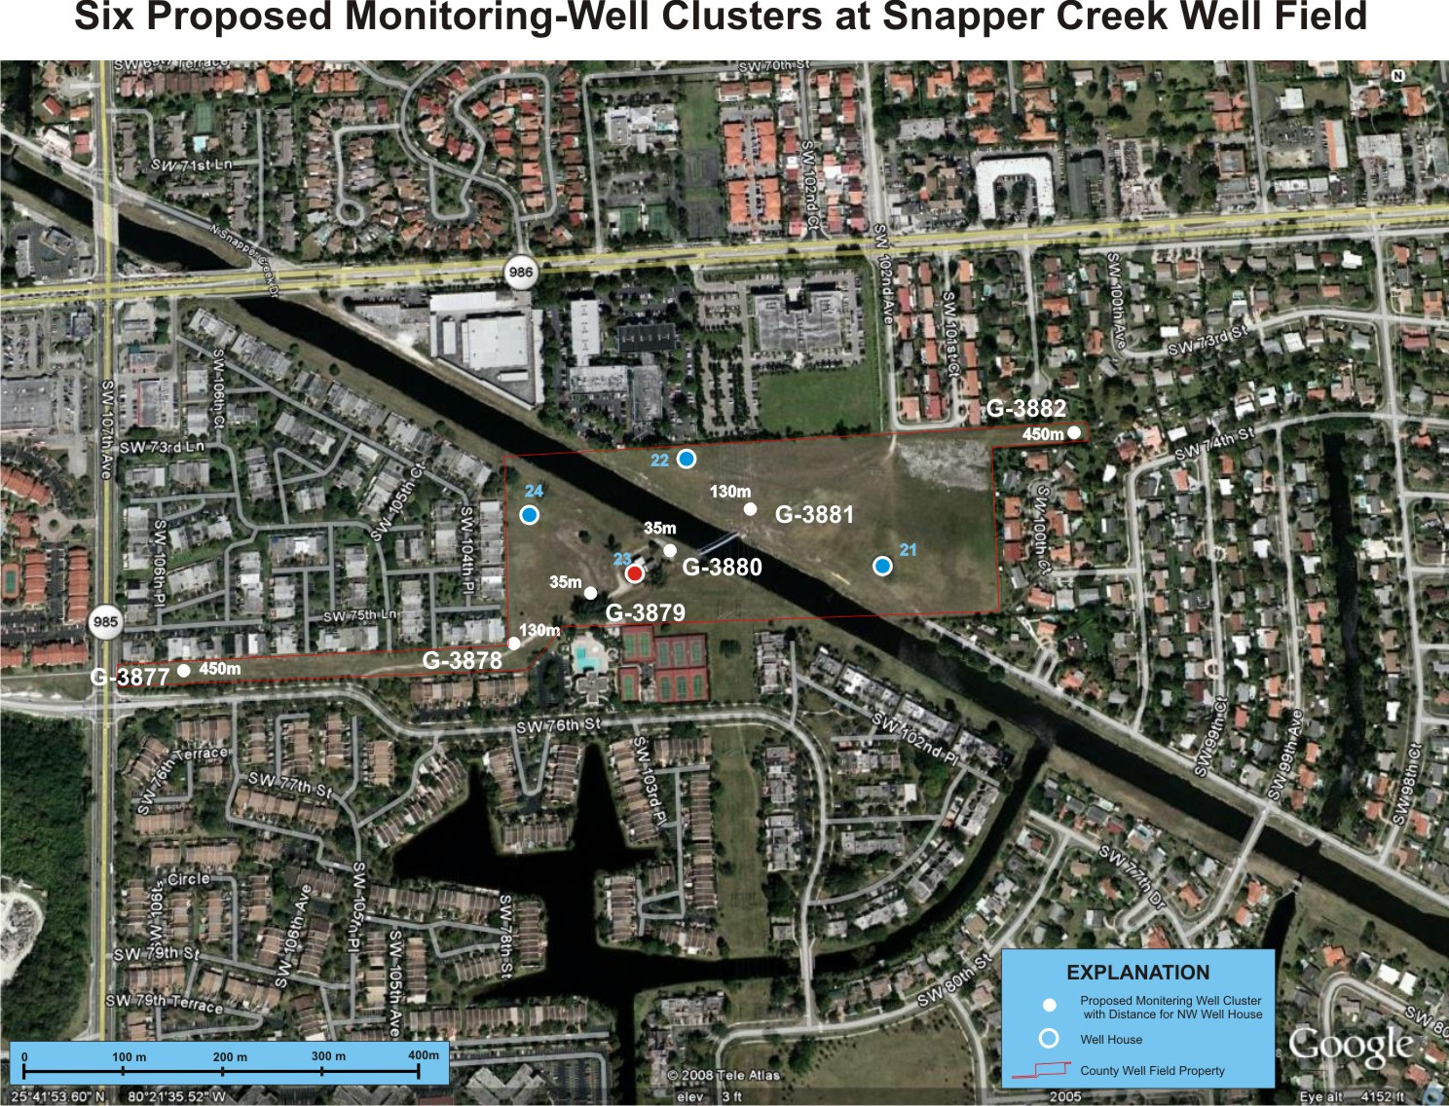
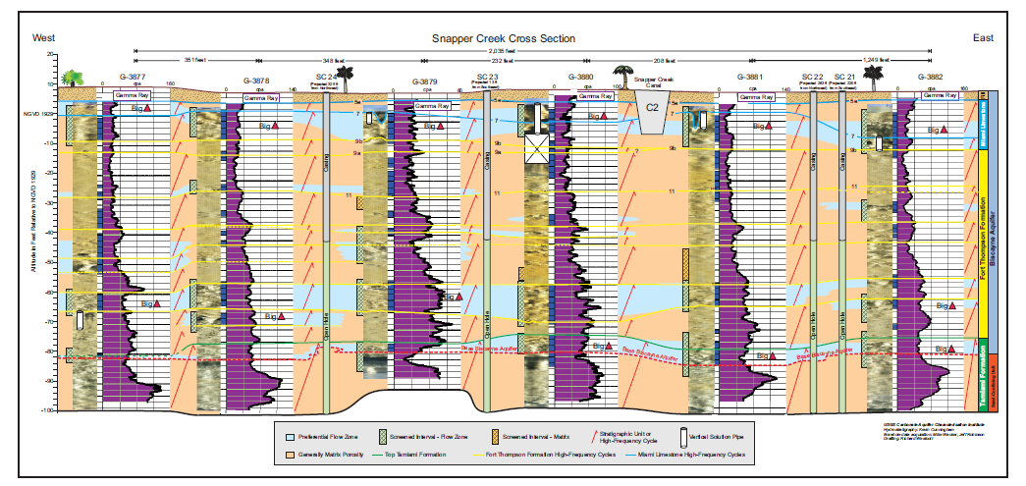
Extensive instrumentation in wellfield:
Groundwater levels at all depths
Pressure in production wells
Temperature and flow data in wells and canal
Evapotranspiration, precipitation and atmospheric gas data

Slide 11
Summary of Wellfield Optimization, Drainage, and Storm Surge Components of Integrated Proposal
Optimize wellfield operations based on environmental and operational criteria, including potential future scenarios
Delineate drainage structure characteristics that affect rainfall-runoff process
Determine potential effects of storm events and storm surge on coastal canals and county facilities

Slide 13
Numerical Tools
UMD model with SWR package canal and control structure operations and groundwater
BISECT model with SWIFT2D hydrodynamic coastal flow and groundwater
South Miami Heights smaller-scale model with URO surface-drainage and wellfield effects
SLOSH models of storm surge dynamics but no groundwater
GWM Groundwater Management Process solves several types of groundwater management formulations to optimize stresses such as wells.

Slide 14
Task 1: Data Collection
Suite of measurements to define hydrology of South Miami Heights area (see main description)
Drainage data collected including depths in drainage structures, isotope and VOC data, rainfall, and flows in canals
Provides necessary information for small-scale model develpement

Slide 15
With the study of hydrology for the planned South Miami Heights Wellfield, investigating the runoff and stormwater drainage process involves much of the same field data and computer modeling

Slide 16
The drainage system predominantly involves on-site drainage with some connectivity to the canal system

Slide 17
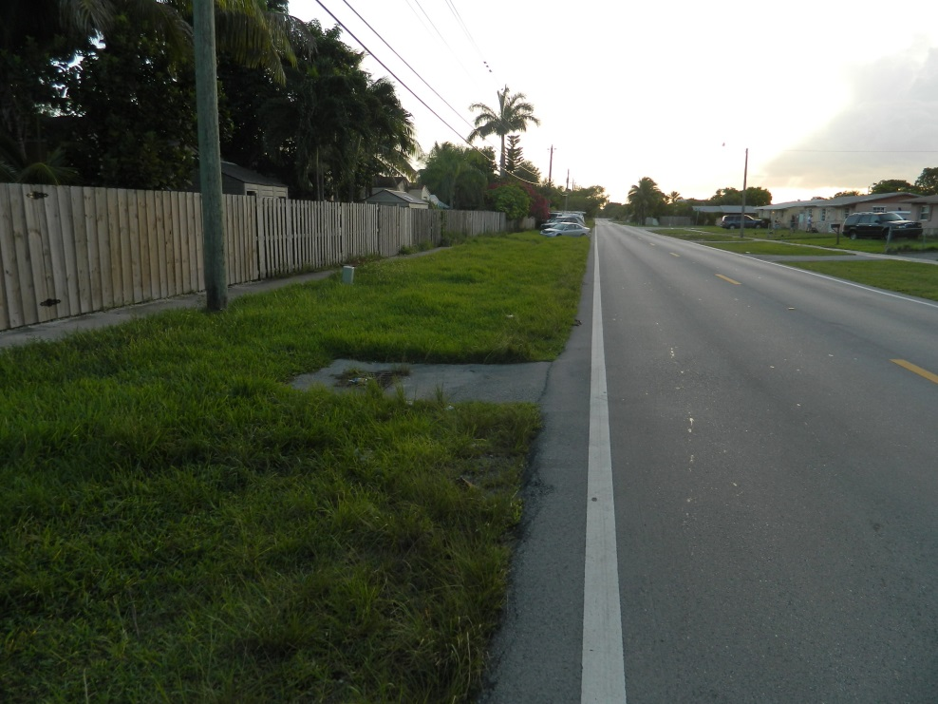
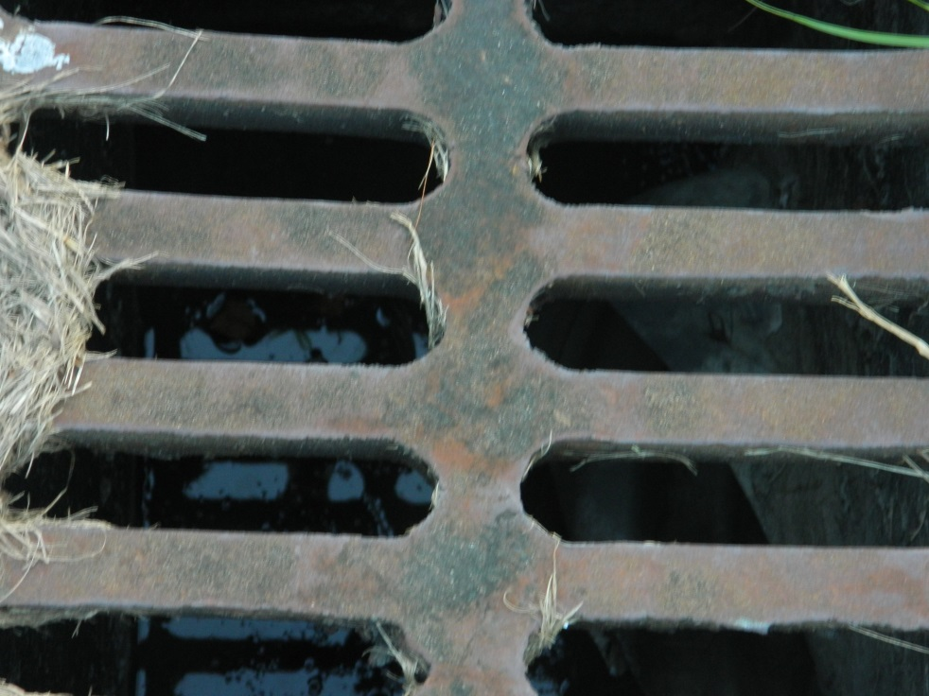
Synoptic measurement of water levels in catch basins will be made periodically, after storm events and subsequent periods. Water samples will also be collected for isotope, VOC, and pesticide analysis.

Slide 18
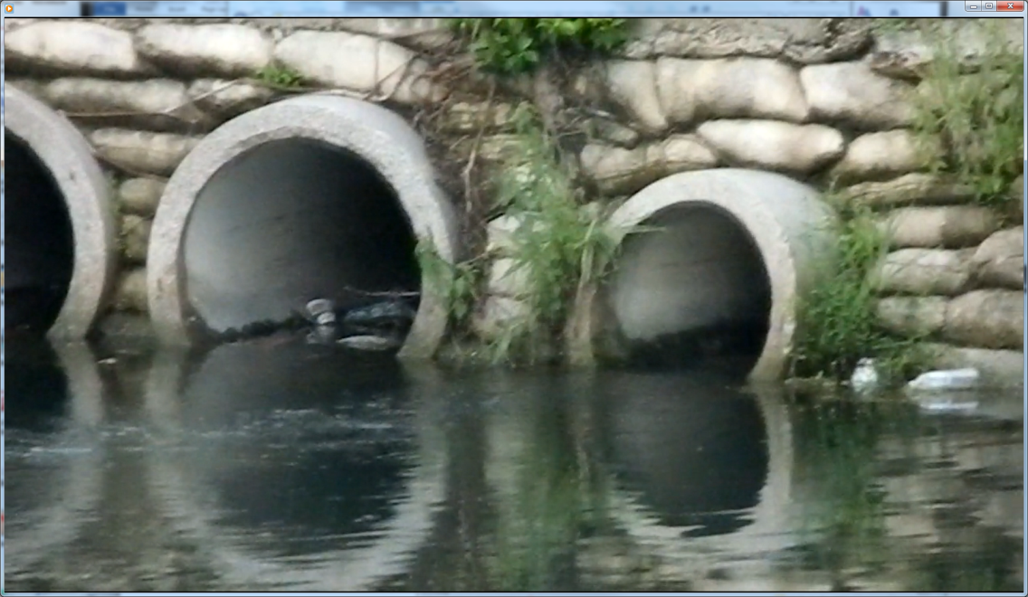
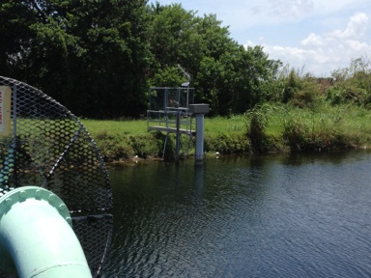
Resources are conserved by combining the drainage information with the monitoring of canal flows and groundwater levels to support the numerical model of the drainage and groundwater flow

Slide 19
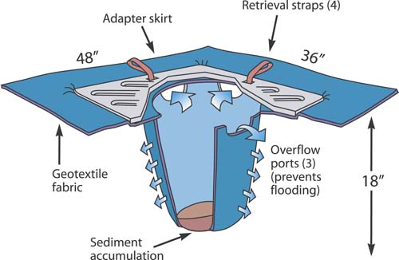
The numerical model will utilize the MODFLOW groundwater code and the Urban RunOff (URO) package to represent the system. It serves the purpose of representing the system for both the potential for wellfield withdrawals and delineating the rainfall-runoff-drainage process.

Slide 20
An additional approach will use multivariate analysis to parameterize the drainage process for general application.

Slide 21
Products: Drainage Study
• Monitoring results and information that can be used to evaluate the current drainage scheme in the study area and develop drainage criteria.
• A small-scale numerical model to represent drainage in the study area and test proposed modifications to the system
• A statistically-derived rainfall-runoff formulation that can be applied to different drainage basins to make stand-alone computation or utilized in a larger-scale hydrologic model
• Better-informed rainfall-runoff representations in hydrologic models of South Florida areas and higher confidence in simulations of storm effects.
• USGS Scientific-Investigations Report documenting the integration of the field data, statistical analyses, and numerical modeling along with a complete description of the developed rainfall-runoff formulation.

Slide 22
Task 2: Local-scale model of drainage/recharge in South Miami Heights area
MODFLOW-based groundwater model with Urban RunOff (URO) module to represent drainage
Integrates drainage data and other hydrology
Simulating the localized effects of storm events
Tool to represent operations of future wellfield and effects

Slide 23
Task 3: County-scale well field optimization using existing integrated County model
Use of operating rules for canal-control structures
Utilizing GWM to optimize wet-season ground-water withdrawals for ASR under varied climatic conditions
Representation of storm impact effects during optimization

Slide 24
Task 4: Development of storm surge model using BISECT and SLOSH
Current hydrodynamic representations of storm surge in BISECT can use SLOSH-generated surge-wave momentum
BISECT simulation determines long-term impact on surface-water and groundwater salinity
Combination of SWR for the canal effects and SWIFT2D for the overland hydrodynamics of the storm surge

Slide 25
Windfield, storm surge, and rain from day of Great Miami Hurricane applied to September 18, 1996
Comparison of hydrologic effects made to Hindcast simulated Great Miami Hurricane
1926 simulation with Great Miami Hurricane repeated with 1996 sea levels

Slide 26
Salinity and inundations before and after hurricane

Slide 27
Inundation increase for storm in 1926 is 24,374 acres
Inundation increase for storm in 1996 is 20,609 acres
However, the 1996 simulation started with 4522 acres more inundated than the 1926 simulation and ended with 757 more acres inundation

Slide 28
Difference in salinity induced by hurricane
The recent storm with higher sea level brought more salinity on the eastern side

