Slide 1

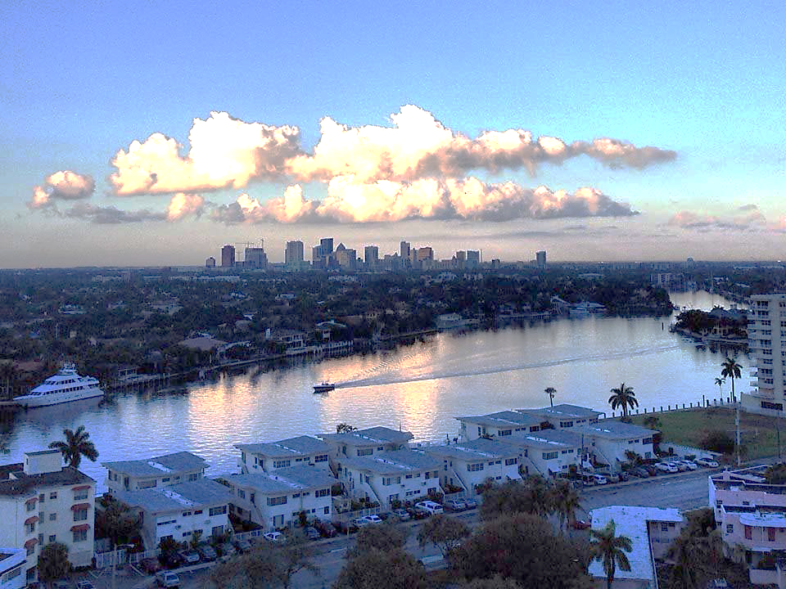
Launch Welcome slide
Tackling Climate Change &
Creating a Sustainable City
Funding Solutions:
The Fort Lauderdale Journey
EMILIE SMITH, BUDGET MANAGER
CITY OF FORT LAUDERDALE
JANUARY 2015
Notes:
1000 Friends of Florida Webinar
Planning for Climate Change at the Municipal Level [title as is stated on the agenda]
Adaptation Action Area Planning – The Fort Lauderdale Journey

Slide 2


Fort Lauderdale Strategic Plan
COLLABORATION WITH OUR PARTNERS

Slide 3
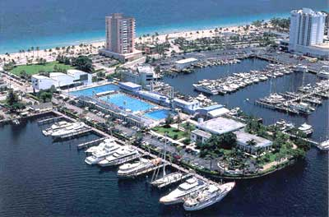
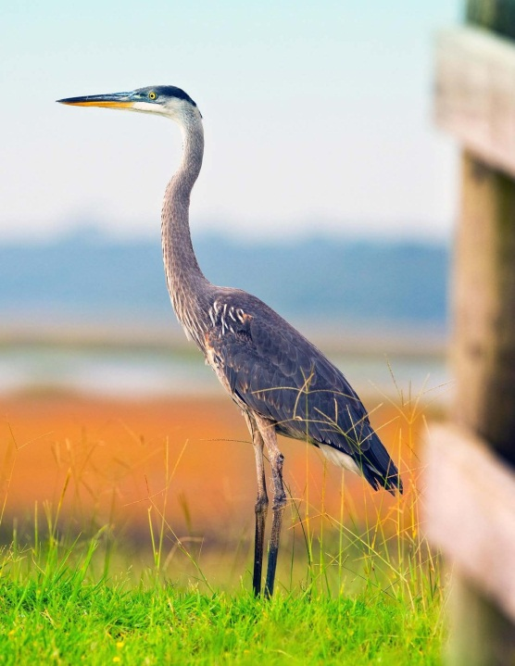
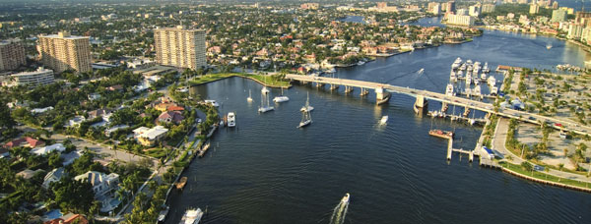

Fort Lauderdale Challenges
COLLABORATION WITH OUR PARTNERS
Renewal and Replacement
New Infrastructure for
Long-term Sustainability and
Resiliency
Reduce Risk
Fair and Equitable for Residents

Slide 4
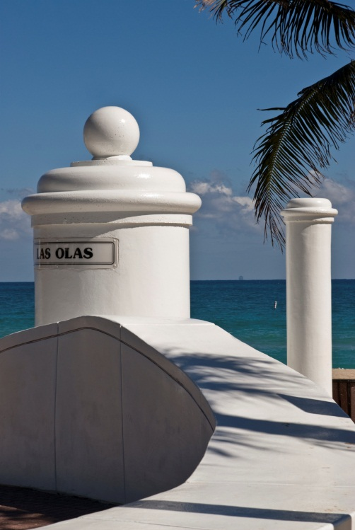
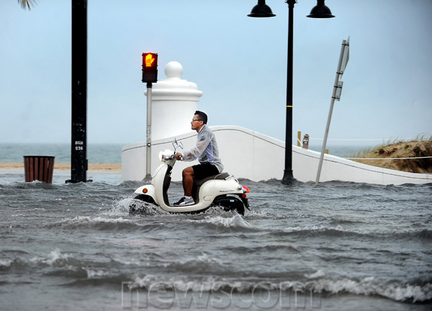
Fort Lauderdale Challenges
COLLABORATION WITH OUR PARTNERS

Slide 5
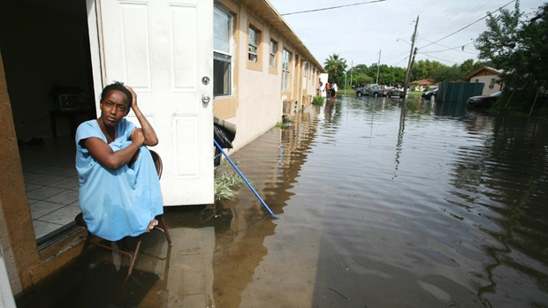
Our Approach
COLLABORATION WITH OUR PARTNERS
Identify Comprehensive Needs
Update Stormwater Assessment Fee
Fair and Equitable Rate Structure
Innovative Approach
Evaluate Alternatives
Define High Risk Areas and Various Property Classes

Slide 6
Estimated Funding Needs
COLLABORATION WITH OUR PARTNERS

Slide 7
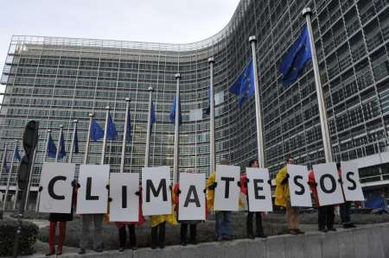
Estimated Funding Needs
COLLABORATION WITH OUR PARTNERS
$12 million over next 4 years
$150 million in Capital Projects in FY 2019
$1 billion over the
next 20 years

Slide 8
The Fort Lauderdale Approach
COLLABORATION WITH OUR PARTNERS
Ten Year Study/Projection
  Stormwater Rate Study
  Interactive Modeling to Test Sensitivity
  Bifurcated or Trifurcated Rate Structure
    Rates Based Upon High Risk Areas and Various Classes

Slide 9
Range of Stormwater Rates
COLLABORATION WITH OUR PARTNERS
Stormwater Rates Across The State
  Lowest = $3.00 per Single Family
  Residential
  Fort Lauderdale Current =
  $4.09 per Single Family Residential
  Highest = $16.67 per Single Family
  Residential

Slide 10
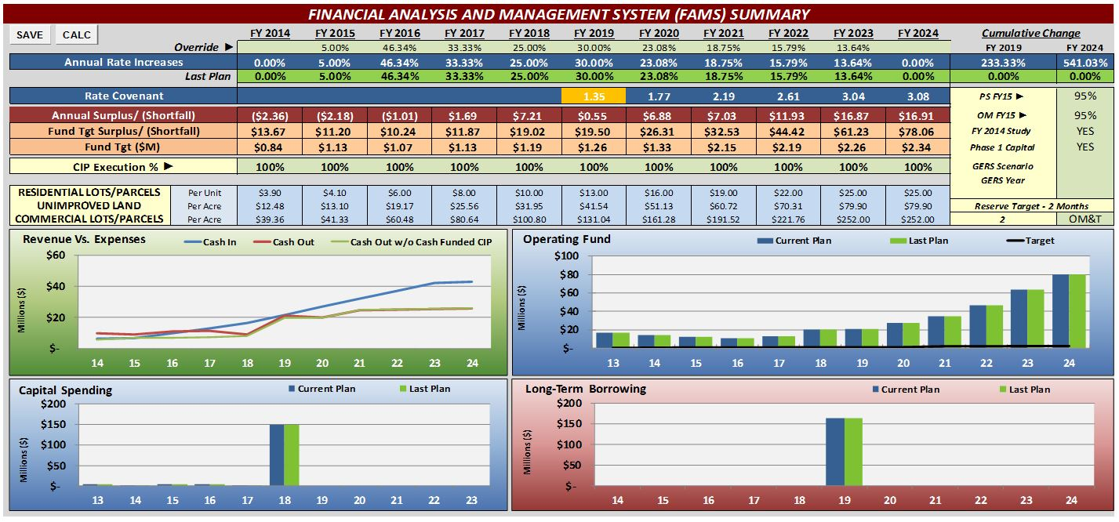
Stormwater 10 Year Study
COLLABORATION WITH OUR PARTNERS

Slide 11
Study Recommendations
COLLABORATION WITH OUR PARTNERS
This Assumes a Flat Rate for All Residential Units

Slide 12
Stormwater Rate Options
COLLABORATION WITH OUR PARTNERS
New Rate Structure Options for Stormwater Assessment Fee
  Flat Rate for Property Class types
    Does not consider risk factors
  Bifurcated System
    Considers multiple property factors
  Trifurcated System
    Considers multiple property factors

Slide 13
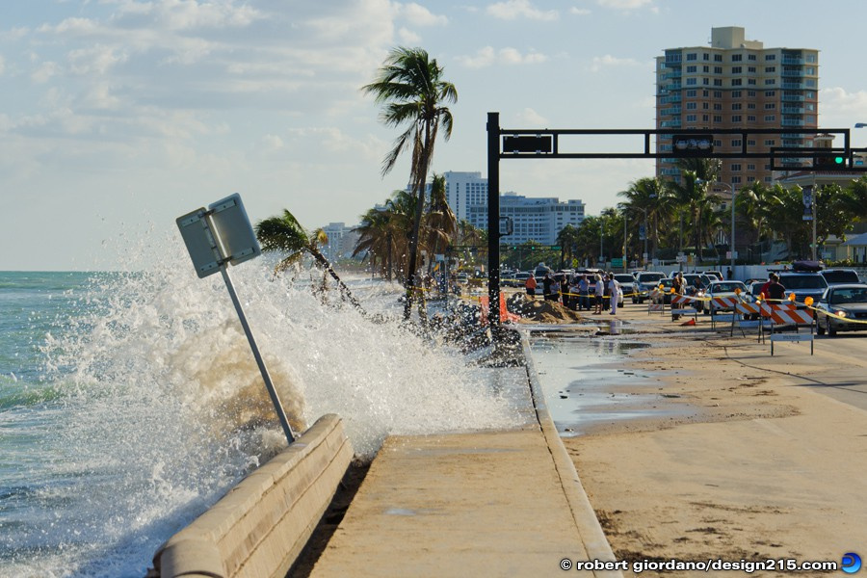
Stormwater Rate Study
COLLABORATION WITH OUR PARTNERS
Factors to Consider in New Rate Structure
  Property Types
  Various Classes and Sizes
  Hydrologic Areas
  Risk Factors
  Low Elevation
  Proximity to Tidal
  Water
  Repetitive Loss
  Properties/Areas

Slide 14
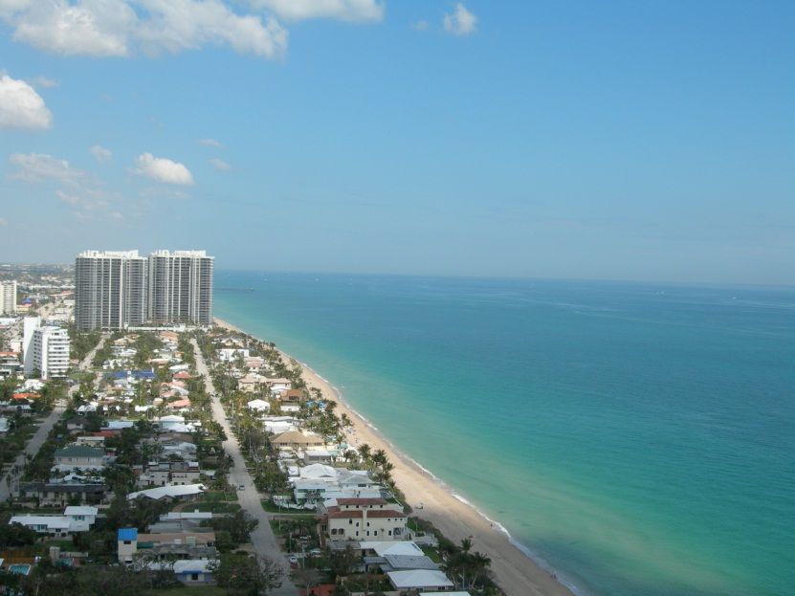
Nest Steps
COLLABORATION WITH OUR PARTNERS
Analyze impact to all Property Classes
Inform and Educate
Present New Rate Structure
with Proposed Budget
Leverage Grant Funds
Leverage various projects
with common goals
Notes:
Susy to speak Conclusions.

Slide 15
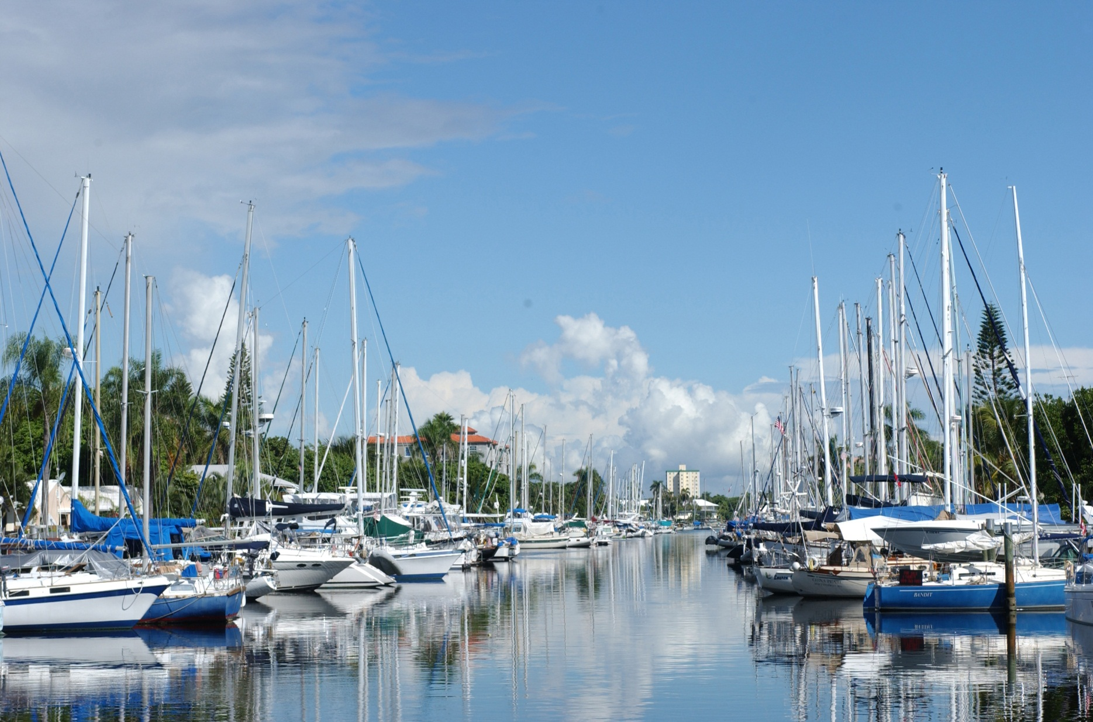
[placeholder] rotation ending slides here
ADAPTATION ACTION AREAS
Thank you!
[placeholder] rotation ending slides here
PLACE HOLDER
END SLIDE
Insert full SUSTAINABILITY LAB IMAGE
Emilie Smith
City of Fort Lauderdale

