Slide 1
City of Satellite Beach

Slide 2
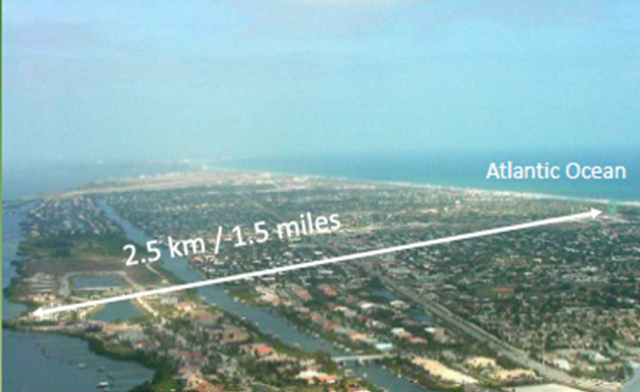
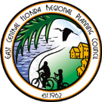
Satellite Beach
Total area of 4.3 square miles
Just over 10,000 residents
98% built out

Slide 3
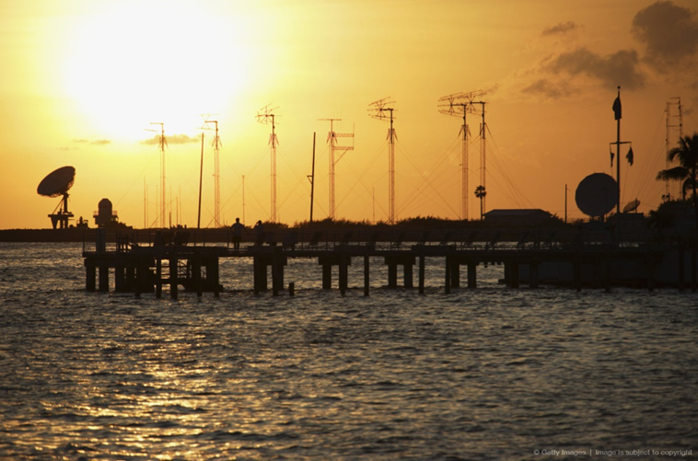
More than half of the City is less than six feet above mean sea level, and a quarter is less than four feet above mean sea level.
Total water frontage of approximately 11.8 miles
Much of the Atlantic Shoreline is “Critically Eroded”

Slide 4
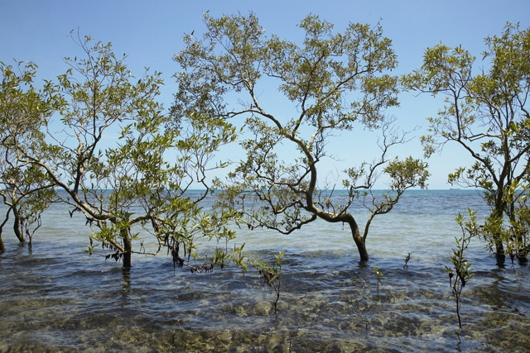
Satellite Beach Climate Ready Estuaries Pilot Project
2009 – 2010
Grant by U.S. Environmental Protection Agency 2009 Climate Ready Estuaries Program
Investigate and assess the potential effects of sea level rise on the City’s infrastructure and resources
Education and Outreach

Slide 5
LiDAR
Vertical datum NAVD88
Local adjustment based on Banana River data and SLR
Final Adjusted MWL(2010) -0.189m

Slide 6
2013 Adaptation Action Area Policy
Objective 1.12A - Development and redevelopment within the City shall be permitted only when consistent with sound planning practices that shall protect life and property from the effects of coastal erosion, flooding, sea level rise, or damage to environmental systems.
Policy 1.12A.2 – The City of Satellite Beach designates the Adaptation Action Area (AAA) as that area which includes the CHHA and other areas of the City as may be identified by the City Council in the future as being subject to coastal erosion, flooding, sea level rise, or damage to environmental systems.

Slide 7
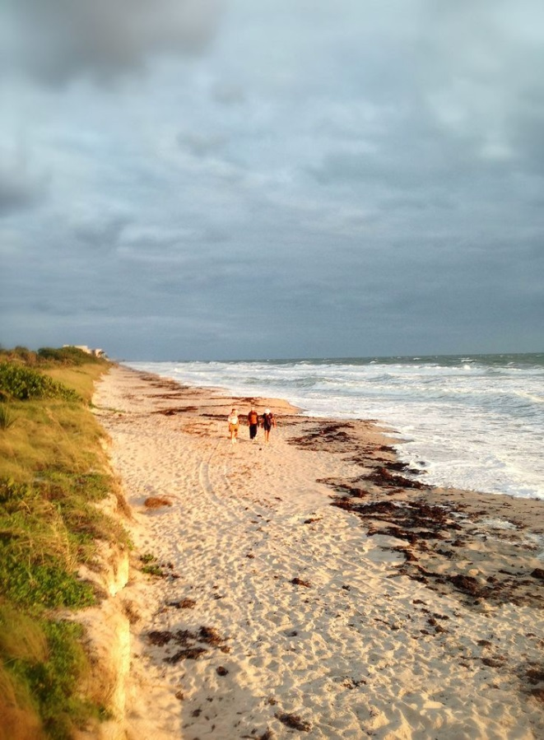
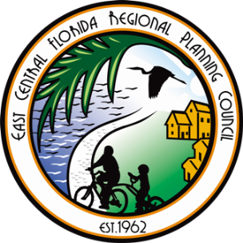
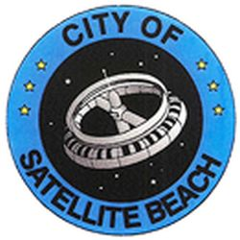
Protecting Paradise
The City of Satellite Beach Community Resiliency Project

Slide 8
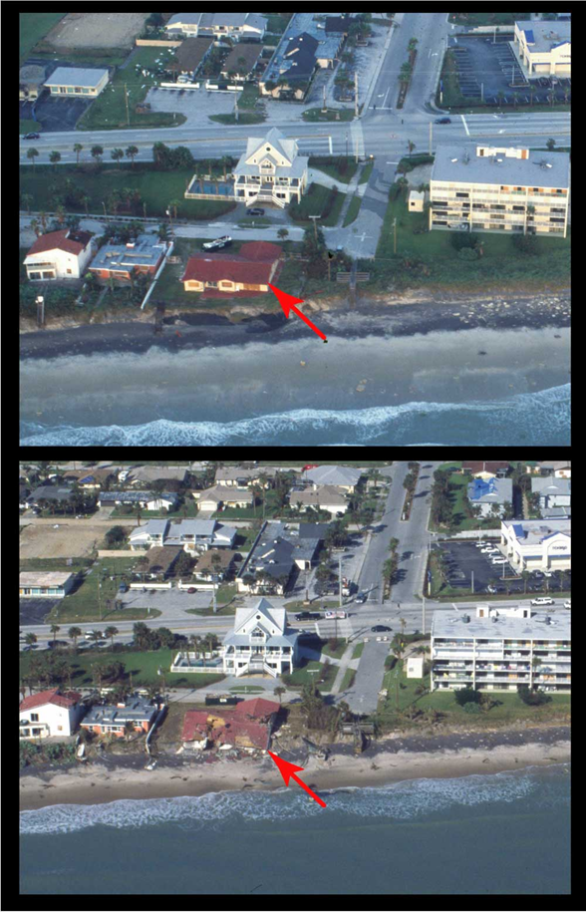
Protecting Paradise Overview
Florida Department of Protection Grant Program – Coastal Partnership Initiative
Development and implementation of AAA criteria and resiliency strategies for Satellite Beach

Slide 9
Project Team
Technical Advisory Team
City of Satellite Beach
East Central Florida Regional Planning Council
Brevard County
Florida Institute of Technology
Florida Department of Economic Opportunity
UF – Florida Sea Grant
City of Satellite Beach
East Central Florida Regional Planning Council
Brevard County
Volusia County
Florida Institute of Technology
Florida Department of Economic Opportunity
U.S Army Corps of Engineers – Planning and Policy Division
UF – Florida Sea Grant
UF - GeoPlan
Space Coast TPO
River to Sea TPO
FDOT
NOAA – Melbourne Office
Environmental Remediation

Slide 10
Protecting Paradise
Conducting Vulnerability and Risk Assessments
Flood
Storm Surge
Erosion
Sea Level Rise
Atlantic Coast
Mean High High Water (NAVD88)
USACE Low, Medium and High Projection Curves
Planning Horizon: 2040, 2070, 2100

Slide 11
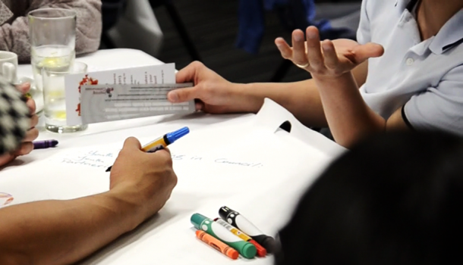
Public Kick-Off Meeting
Sept. 23
Panel of Speakers
Project Overview
Vulnerability Overview
AAA Education
Public Engagement Activities

Slide 12
Contact Information
Tara McCue, AICP
Director of Planning and Community Development
East Central Florida Regional Planning Council
tara@ecfrpc.org
407-262-7772 ext. 327

