Slide 1
Yankeetown-Inglis
Proposed Adaptation Areas
Kathryn Frank
University of Florida
August 28, 2014

Slide 2
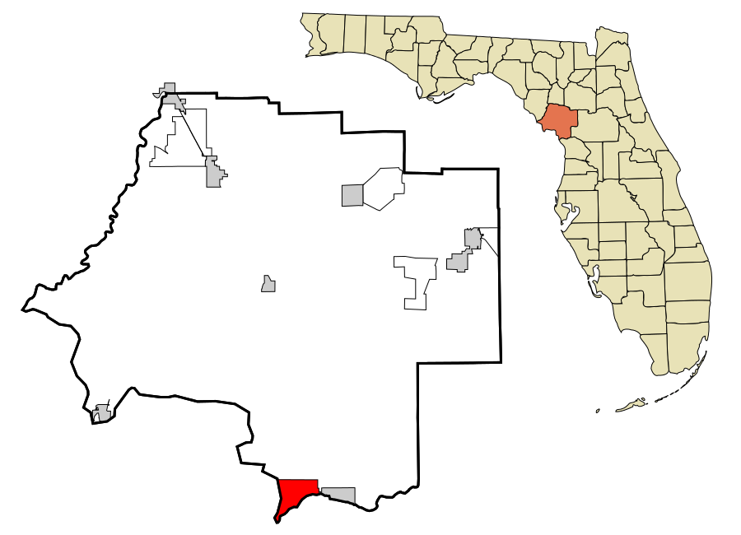
Yankeetown-Inglis Adaptation Planning
Planning for Coastal Change in Levy County
  Yankeetown-Inglis Adaptive Design, Summer 2013
  Kathryn Frank (Urban and Regional Planning)
Yankeetown Natural Resource Adaptation Action Area
  Thomas Ankersen (Law Conservation Clinic) and David Kaplan (Watershed Ecology Lab)
  2013-14
Yankeetown and Inglis
Pop. 500 and 1300

Slide 3
Sea Level Affecting Marshes Model (SLAMM)

Slide 4
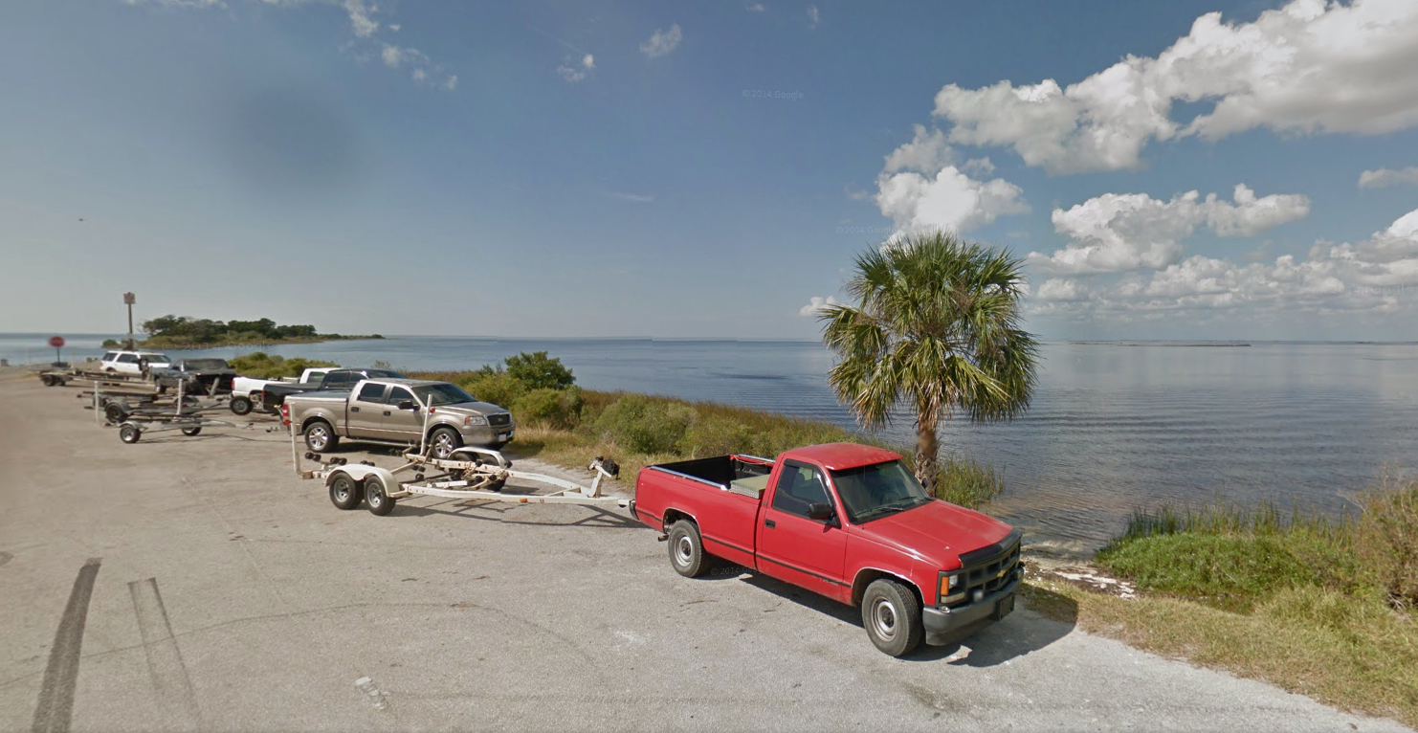
Vulnerable Developed Floodplain
Undeveloped Yankeetown
Historic Inglis
Vulnerable Natural Floodplain
0
Gulf Gateway
Vulnerable River
Rural-Suburban Inglis
Proposed Adaptation Areas

Slide 5
Approach: Complementary, opportunity
0
NATURAL RESOURCE AAA

Slide 6
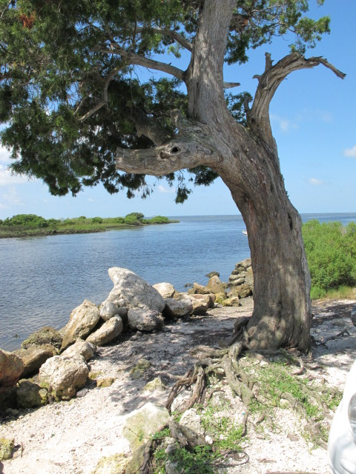
Potential Implementation
Floodplain management and Community Rating System
Comprehensive Plan and Land Development Code

Slide 7
ChangingLevyCoast.org
Kathryn Frank
kifrank@ufl.edu

